Slide 1
Bosco Sodi’s Muro
A Look at Border Walls through Contemporary Art
Notes:
Teacher: Students, today we are going to learn about contemporary Mexican artist Bosco Sodi whose latest artwork, Muro, focuses on the political narrative of border walls and societal agency.
Image: Bosco Sodi with Muro (2017) Photo Robert Castagna, Courtesy of Studio Bosco Sodi
Source: https://www.theartnewspaper.com/blog/another-brick-in-the-wall-bosco-sodi-brings-political-performance-to-london

Slide 2
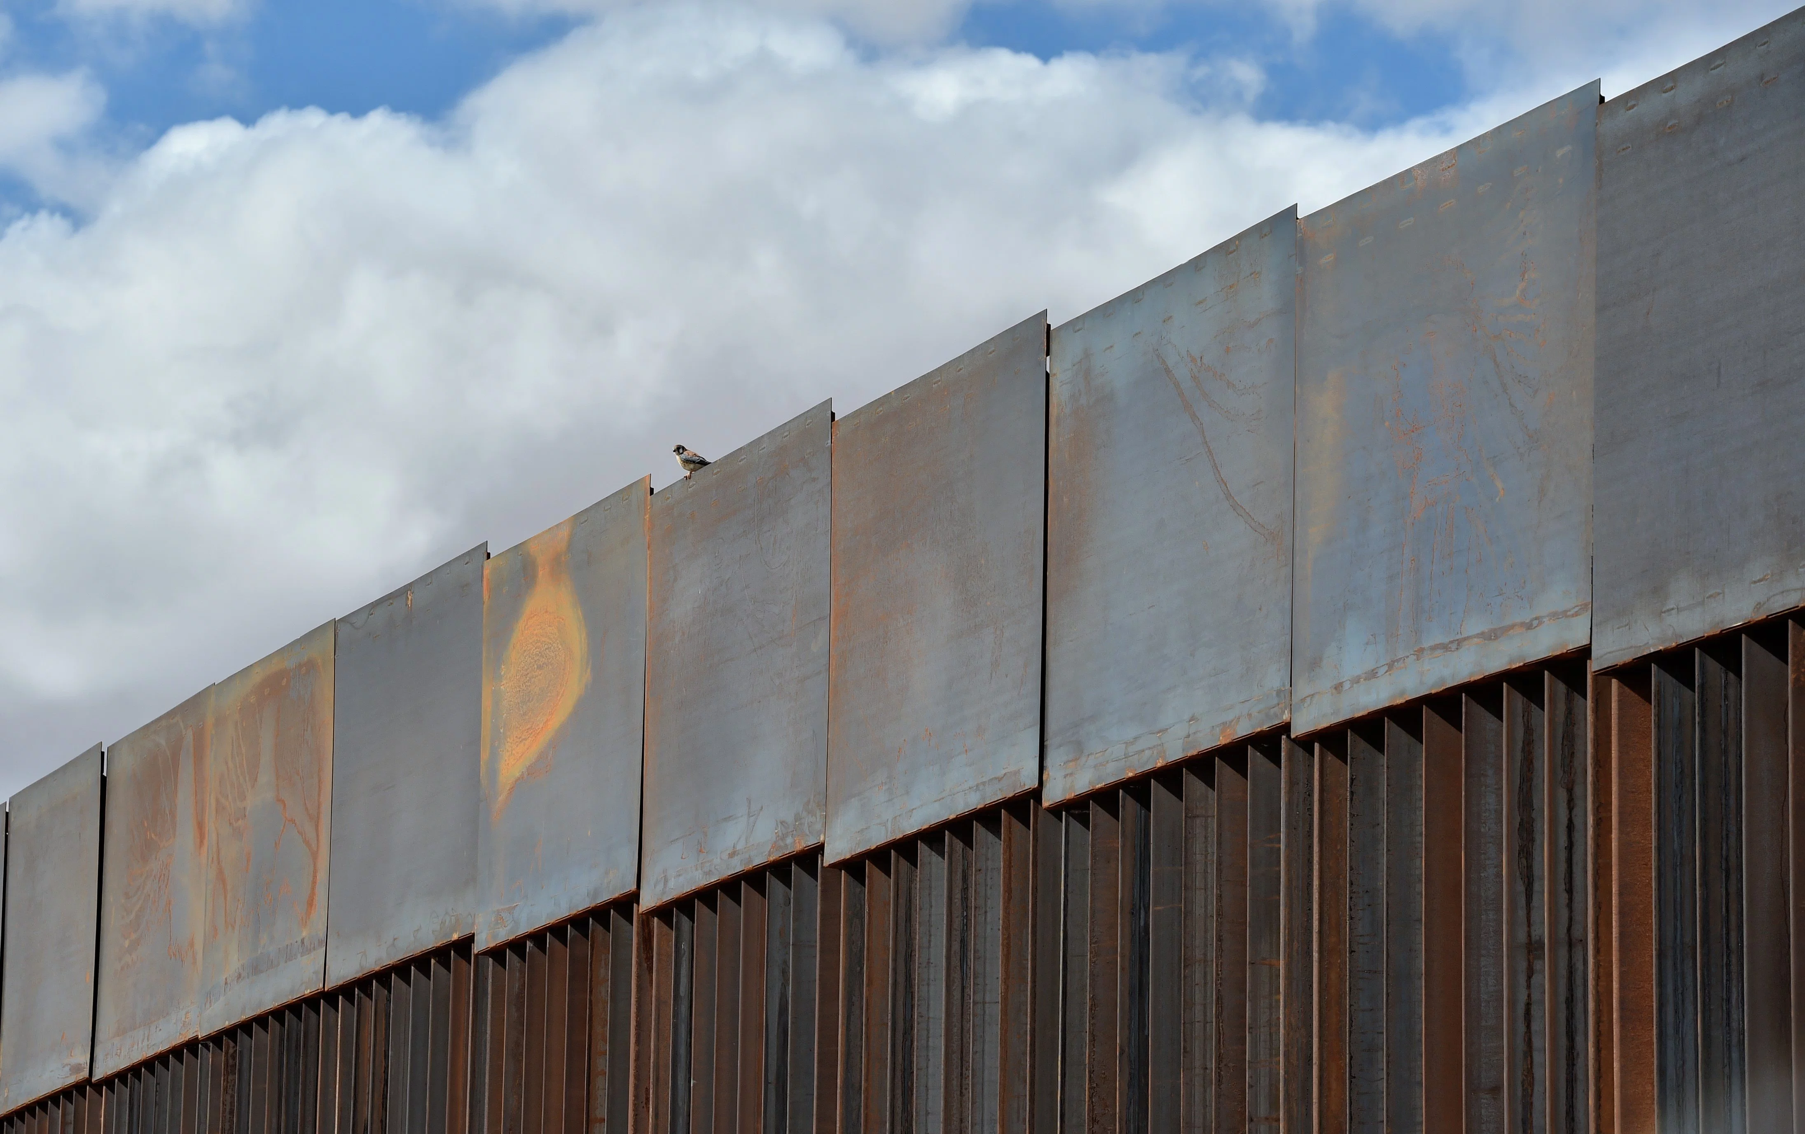
Think, Pair, Share
Consider the following statements:
Walls are meant to protect and defend.
Walls separate or divide.
Which statement do you agree with more?
Why?
Notes:
Teacher: Before we explore Sodi’s art, let us think about and discuss concept of border walls
Consider the following statements:
Walls are meant to protect and defend.
Walls separate or divide.
With a partner, discuss each statement. Which statement do you agree with more? Why?
We will then share responses with the class.
Image Source: http://time.com/4729470/mexico-border-wall-trump-undocumented-immigrants/

Slide 3
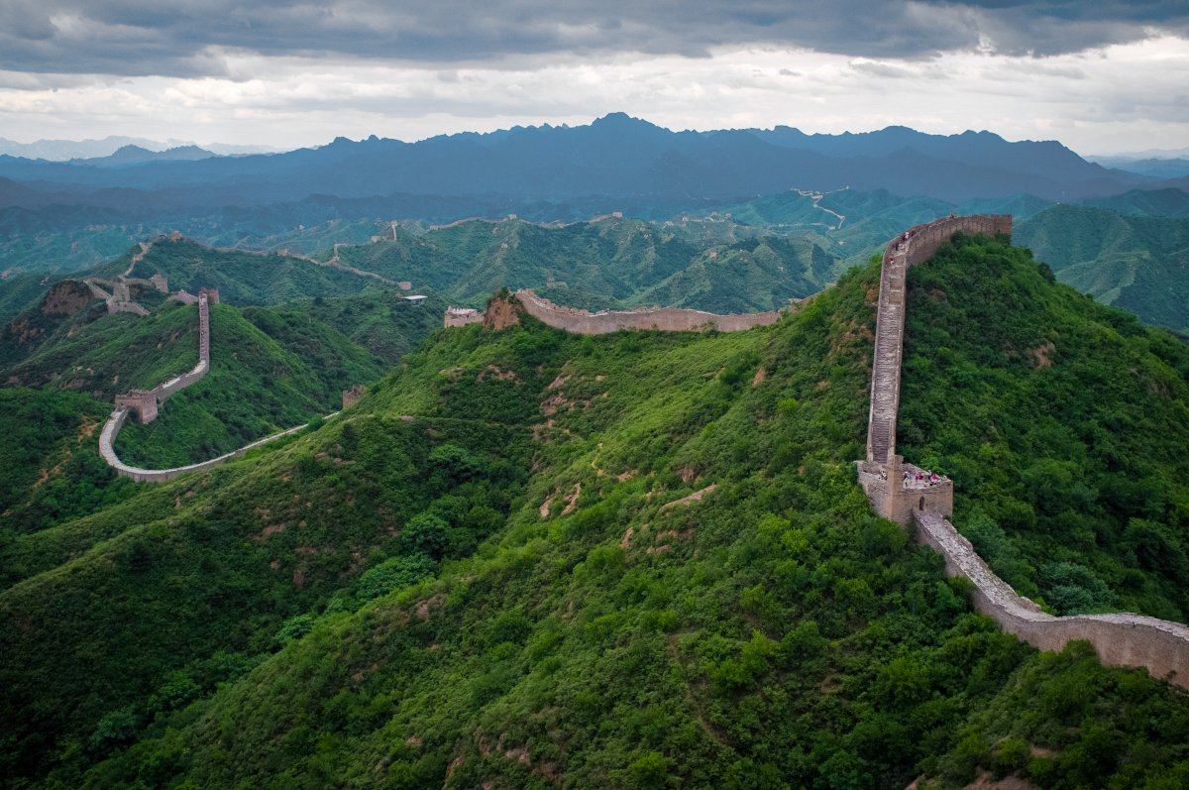
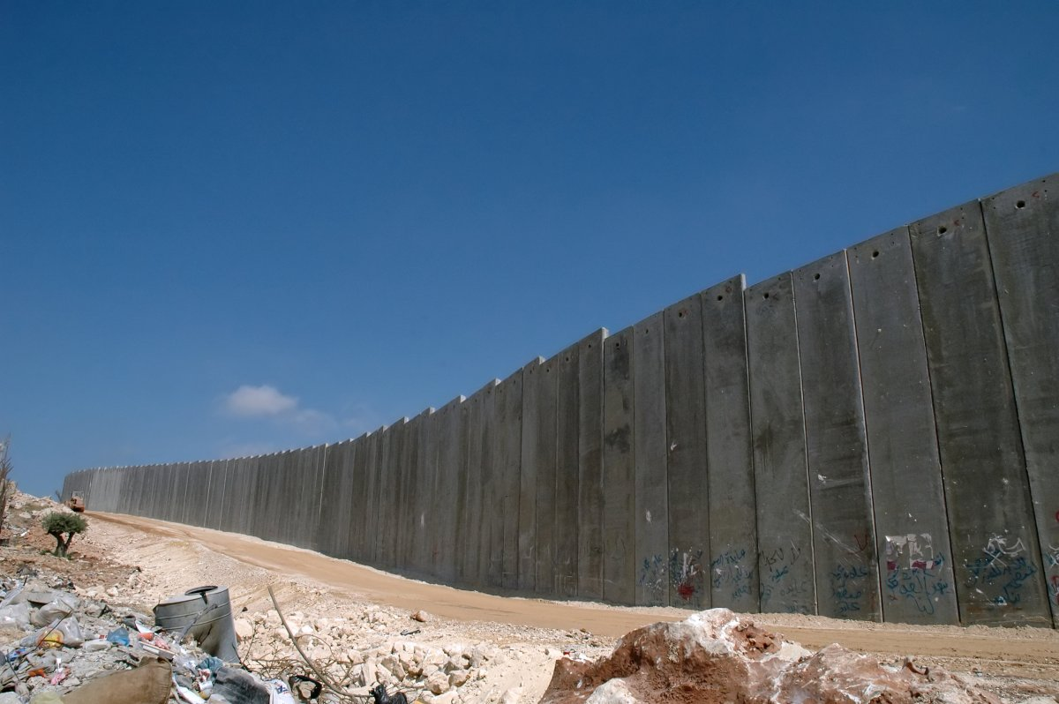
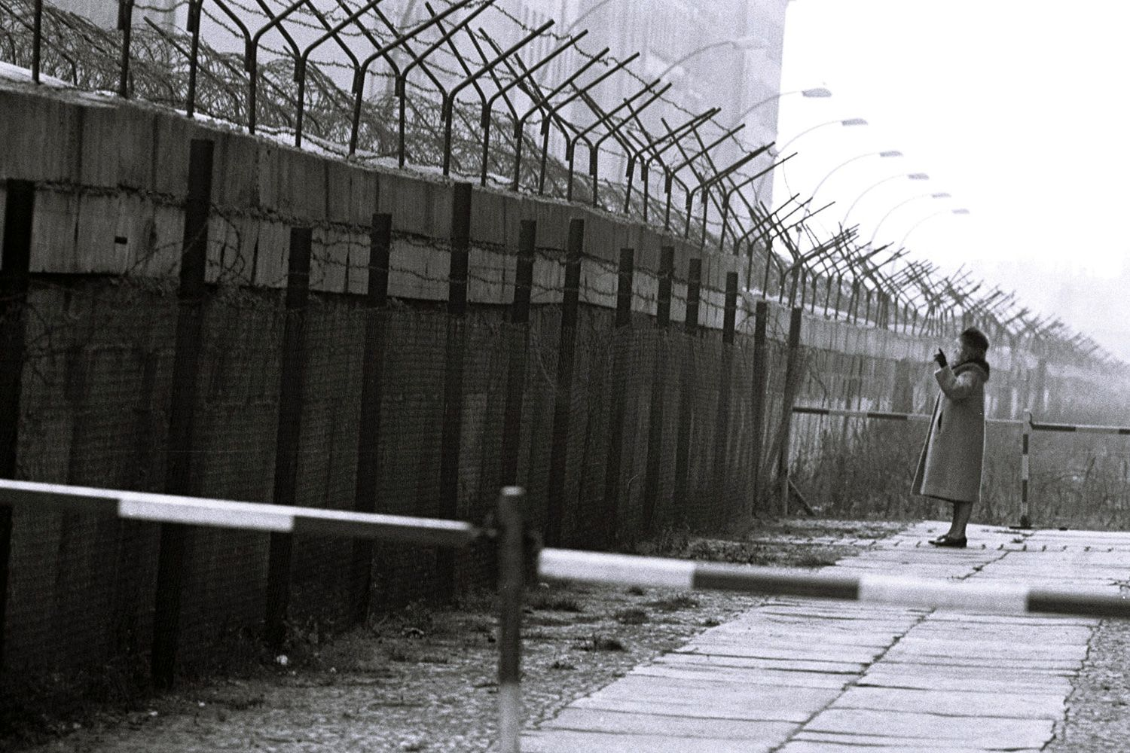
The Great Wall of China
(Above)
The West Bank Barrier, Israel
(Above)
The Berlin Wall, Germany
(Left)
Notes:
Teacher: Border walls are not a modern invention. Several civilizations and nations have erected walls for different reasons. We will briefly discuss one contemporary and two historically significant walls- The Great Wall of China (China), The West Bank Barrier (Israel), The Berlin Wall (Germany). As we explore these structures, consider asking yourself, did these walls defend or divide? Write down your thoughts on the guided notes sheet.
Sources of images: http://origins.osu.edu/connecting-history/top-ten-origins-walls
https://fthmb.tqn.com/OafQdhIOgHhoVv2_714u16L3uys=/1500x1000/filters:fill(auto,1)/BerlinWall-58a5f8bd3df78c345b549131.jpg

Slide 4
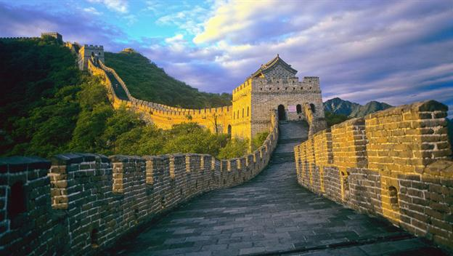
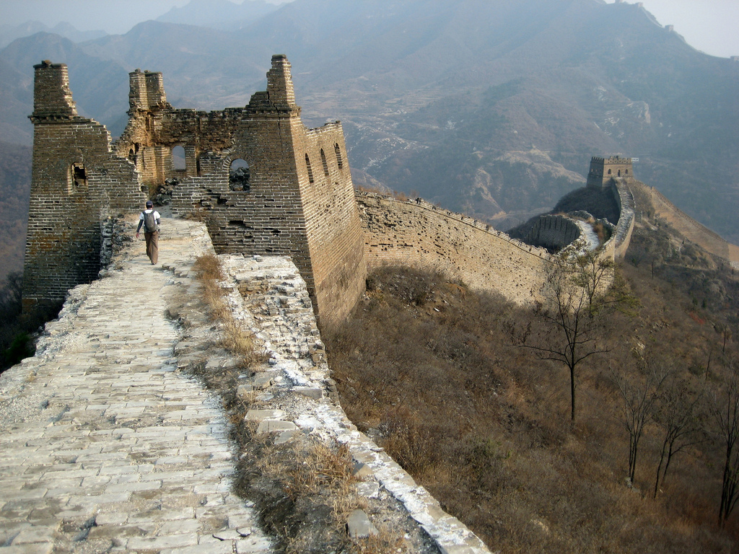
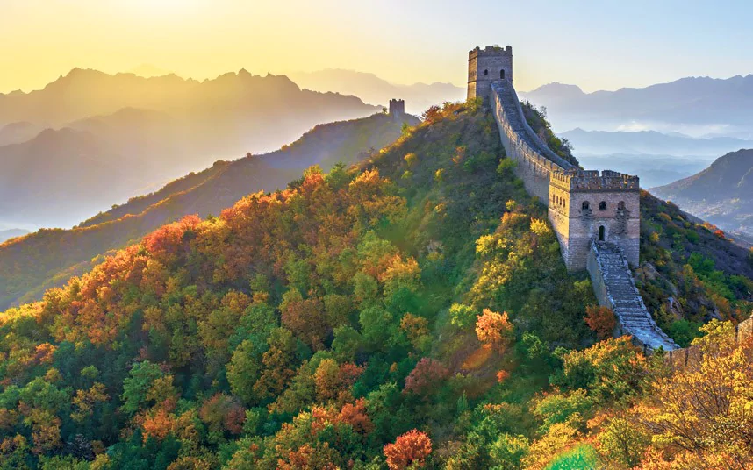
The Great Wall of China
Intent to defend China
Failure of the wall was marked by Genghis Khan’s successful invasion of China
Notes:
Teacher: The Great Wall of China has an extensive history which began with the Qin Dynasty (221-206 BCE). It took hundreds of years to construct the expansive and continuous 5,500 mile long barrier. A purpose for this structure was to defend China from Mongol and Manchu invaders. However, the wall ultimately failed in defending China. Gengis Khan, leader of the Mongols, and other groups such as the Liao, the Jin, and the Manchus all managed to invade and conquer areas of China.
Sources: http://origins.osu.edu/connecting-history/top-ten-origins-walls
https://www.ancient.eu/Great_Wall_of_China/
Image sources: https://www.history.com/topics/ancient-china/great-wall-of-china-video
https://www.telegraph.co.uk/travel/destinations/asia/china/articles/china-travel-guide/
https://news.artnet.com/art-world/china-report-of-great-wall-312912

Slide 5
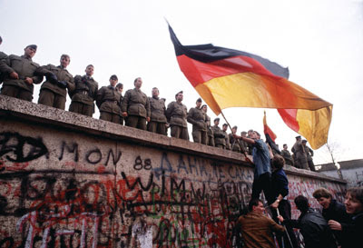
The Berlin Wall
Stop emigration from East to West Germany
Symbol of the Cold War divide (Communism/Democracy)
Notes:
Teacher: Soviet-occupied East Germany began constructing the Berlin Wall on August 13, 1961. The intent was to stop emigration from East Berlin to West Berlin. Because of this wall, people suffering oppressive living conditions in East Germany were unable to leave. Many families were separated and many died trying to get over it. Ultimately, the Berlin Wall became a Cold War symbol that divided the world between the communist East and the democratic West. The destruction of the Berlin Wall, November 9-10, 1989, signified a new era in global politics.
Source: https://www.nato.int/cps/en/natohq/declassified_136311.htm
https://berlinwall.pressbooks.com/chapter/the-significance-of-the-wall/
Image sources: https://www.nato.int/cps/en/natohq/declassified_136183.htm
https://berlinwall.pressbooks.com/chapter/the-significance-of-the-wall/

Slide 6
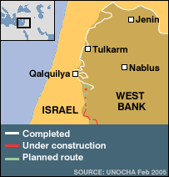
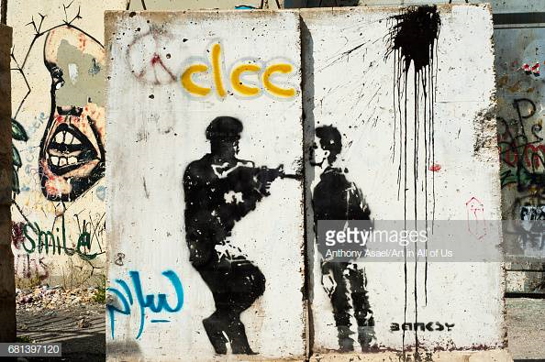
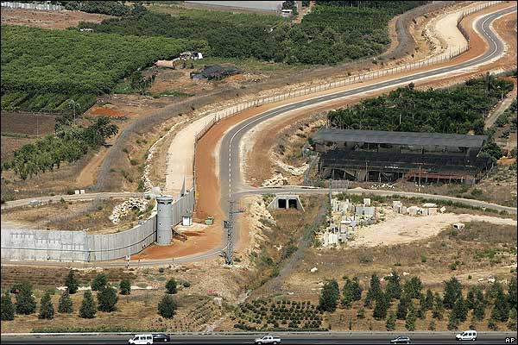
The West Bank Barrier
Israeli government claims barrier is to protect citizens against terrorism
Israeli critics argue its an attempt to seize more Palestinian territories
Notes:
Teacher: Construction of this barrier began in 2000. The Israeli government states that the wall is being built to protect Israeli citizens from suicide bombers and radical terrorist organizations. Israel’s critics argue that the barrier is an attempt to further seize Palestinian territories. While construction of this barrier continues, many nations committed to the Israeli-Palestinian peace process believe the barrier creates obstacles to achieving peace. The Israeli government claims terrorist attacks have decreased as a result of this barrier.
Sources: http://origins.osu.edu/connecting-history/top-ten-origins-walls
http://news.bbc.co.uk/2/hi/middle_east/3111159.stm
Image Sources: https://www.gettyimages.co.uk/detail/news-photo/israeli-built-west-bank-wall-surrounding-bethlehem-with-news-photo/681397120
http://news.bbc.co.uk/2/hi/middle_east/3111159.stm

Slide 7
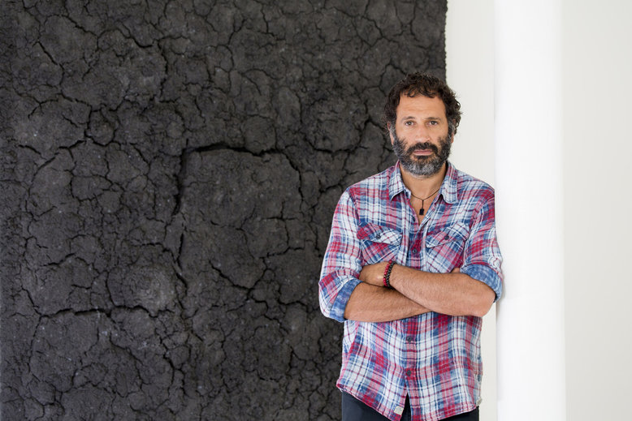
Bosco Sodi
Born in Mexico City
Muro (“wall” in English) was first built in NY on Sept 8, 2017
1600 clay bricks made in Mexico by local craftsman
Response to Trump’s border wall
Notes:
Teacher: Sodi was born Mexico City in 1970, and currently lives in New York City, NY due to an artist’s visa. This means he has permission to stay temporarily in the United States.
His installation Muro challenges governments’ reasons for constructing border walls and engages viewers to be actively bring down barriers.
Muro was constructed of 1600 clay bricks made in Mexico. Each brick had a unique color, which according to the artist, was a metaphor for the dream that is the United States.
Muro was first built in Washington Square Park, New York on 8 September 2017 in response to Trump’s proposed southern border wall between the United States and Mexico.
Top Left Image: Bosco Sodi
Source: http://www.magazinedigital.com/buena-vida/arquitectura/bosco-sodi
Bottom Right Image: Image: WASHINGTON SQUARE PARK, NY USA Public Installation 2017
Source: https://www.boscosodi.com/fullscreen-page/comp-irngk5za/77551414-3539-47a8-a78e-df4d4e99009c/50/%3Fi%3D50%26p%3Dc1lo9%26s%3Dstyle-jhjedgbe

Slide 8
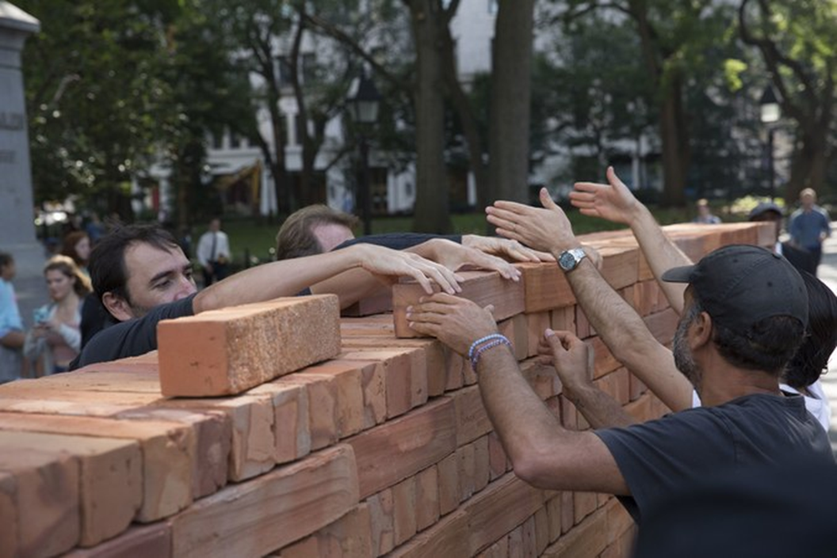
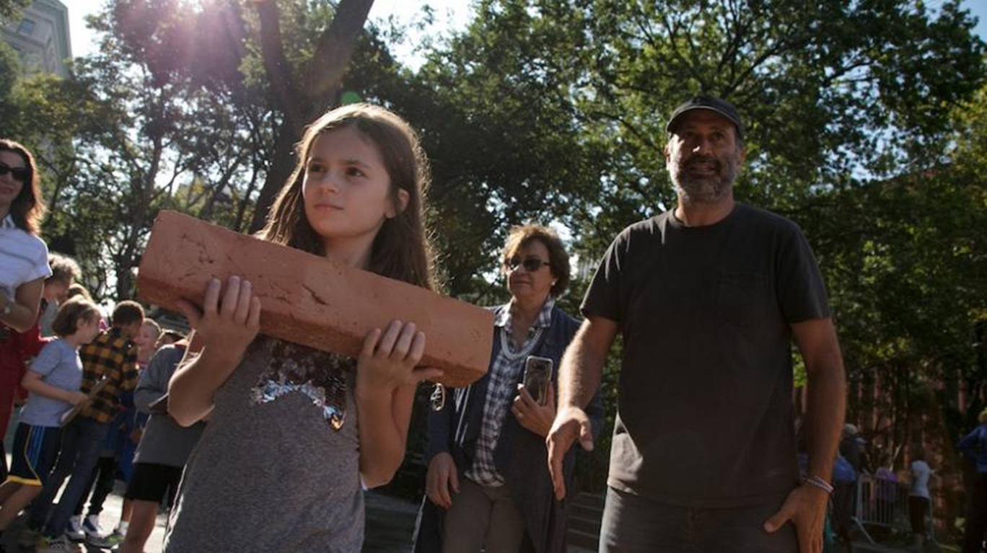
Sodi’s Muro
Viewers are then allowed to take bricks, effectively tearing down the wall
Civic action and social justice
Notes:
As part of the exhibit, Bosco invited viewers to take one brick between the hours of 3 and 8 p.m. The wall was “torn down” by people on both sides of the wall, suggestively breaking down physical and mental barriers.
Sources:
https://www.metro.us/news/local-news/new-york/washington-square-park-wall-art-muro-art
https://www.wmagazine.com/story/mexican-artist-bosco-sodi-wall-washington-square
https://archpaper.com/2017/12/bosco-sodi-muro-clay/

Slide 9
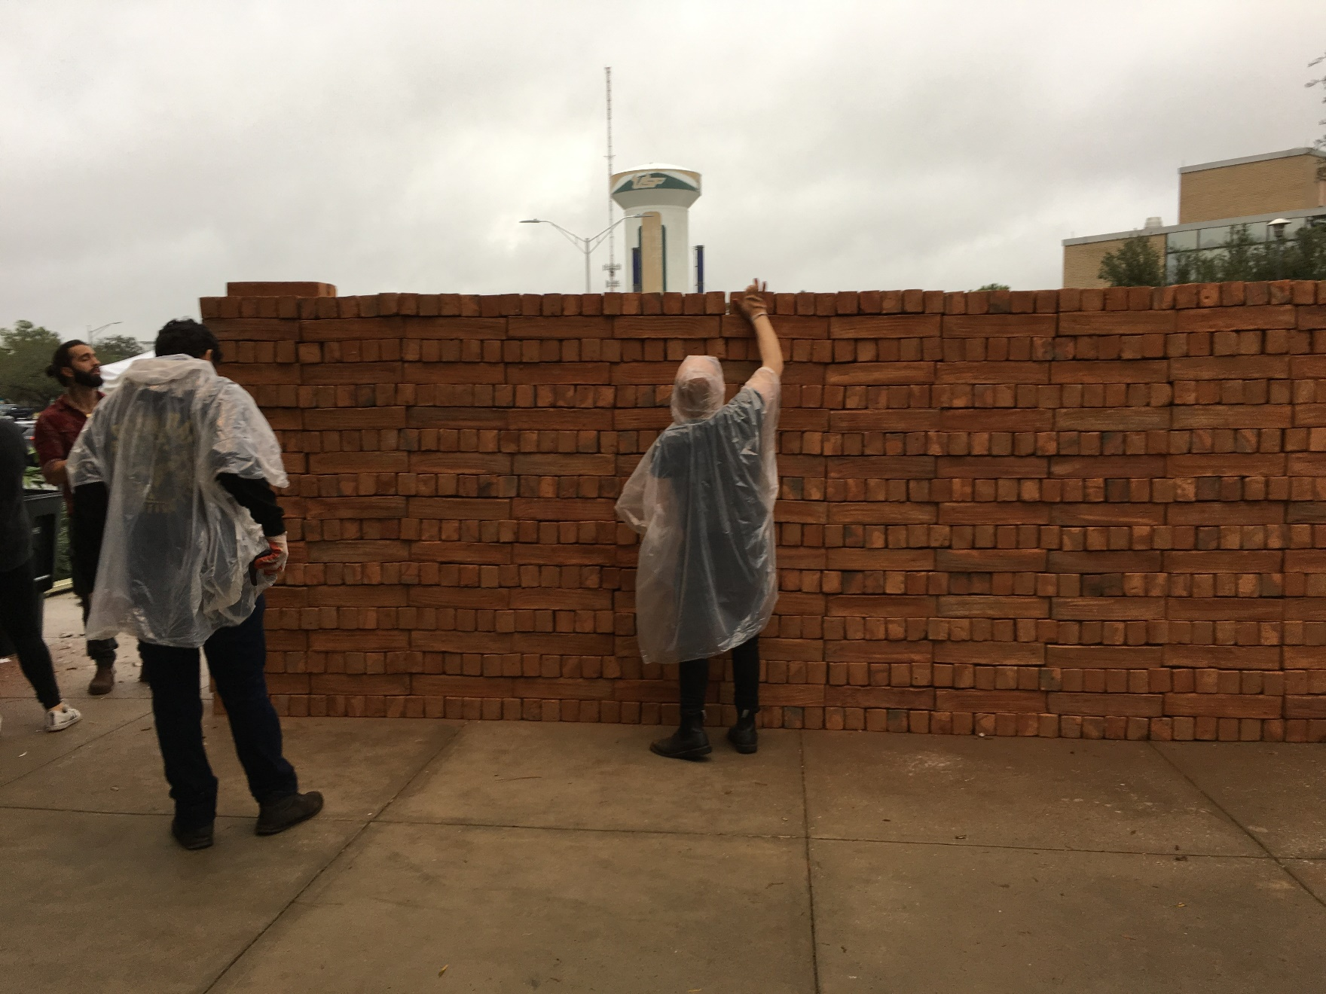
Sodi’s Muro
https://www.youtube.com/watch?v=R_pvtEekcrk
“This is not just a political wall… Any human being confronts hundreds of walls during his life. I took those ideas to show a social exercise… to show how easy it is to build a wall, but how easy also it is to dismantle a wall… when society gets together and wants to change something, it can change it very easily even if it’s brick by brick or small part by small part.”
- Bosco Sodi, Public Installation and Performance; January 24, 2019, USFCAM

