Slide 1
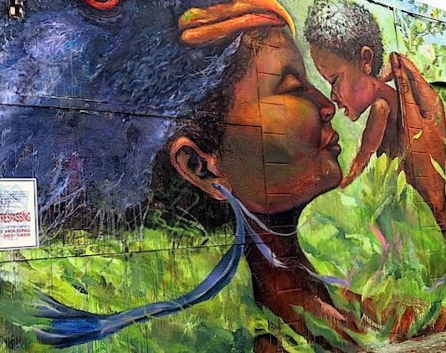
Little Haiti: Exploring Haitian American Community and Identity Through Art

Slide 2
Learning Objectives:
1. Students will be able to explore the concept of enclave communities. 2. Students will be able to relate immigrant communities to identities. 3. Students will be able to evaluate self identity and community expression through art. 4. Students will be able to create murals representing their self identity and community.

Slide 3
What Makes a Community?

Slide 4
What does it mean to be a member of a community?
Who makes up the membership of a community?
How can you identify members of a community?
What types of objects or images help identify communities?

Slide 5
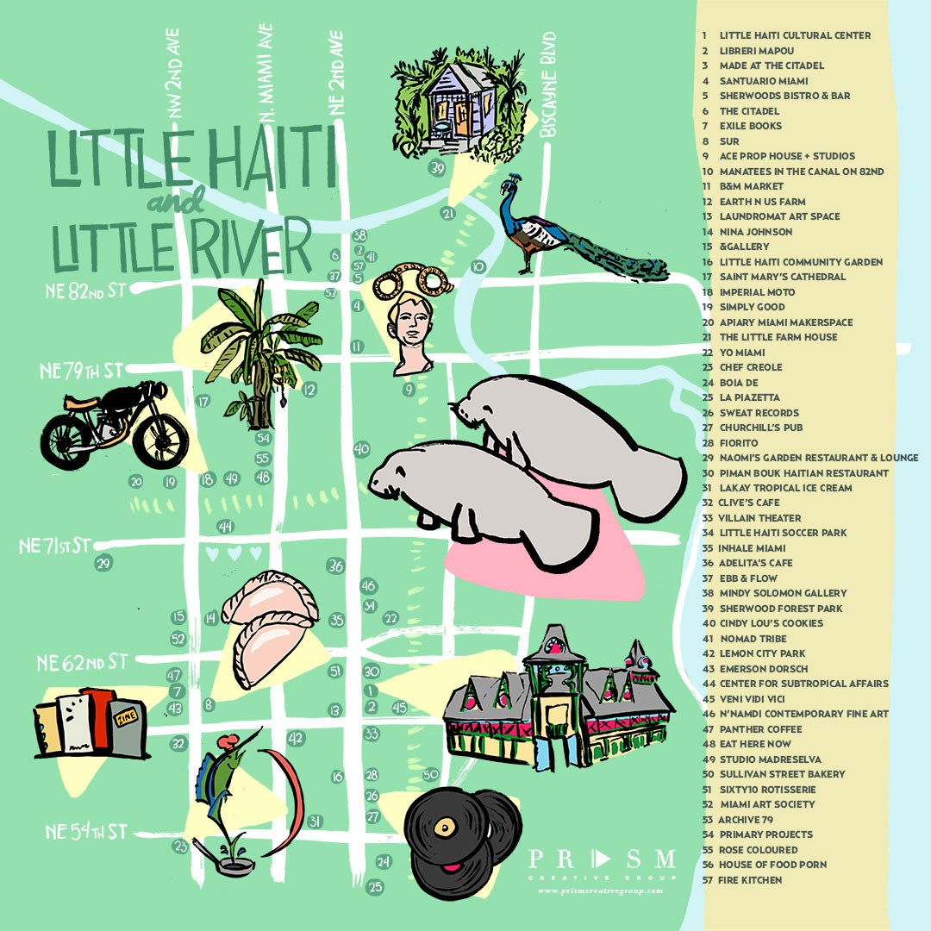
Little Haiti, Miami, Florida
Let's think: What is an enclave community?
Enclave communities are small communities that share cultural traits that unite individuals into a community. These shared traits can be language, religion, ethnicity, etc. Many times these communities develop as groups of people immigrate to a new country.
What enclave communities can you think of that might exist in your community? In your state? In your country?

Slide 6
Identity, the self, and community
Sometimes individuals can belong to multiple communities forming complex identities. These communities could include family, school, or community groups. Brainstorm: can you identify different communities that you belong to?
Art can help individuals express their own identity and their community identity. Photographs and murals are two ways artists try to express identity.

Slide 7
As you watch record: What do I see? What do I hear? What is unique about the community identity of Little Haiti?

Slide 8
Widline Cadet is a Haitian-born artist. Her practice draws from personal history and examines race, memory, erasure, migration, immigration, and Haitian cultural identity from within the United States. She uses photography, video, and installations to construct a visual language that explores notions of visibility and hyper visibility, black feminine interiority, and selfhood.
What might Widline Cadet mean when she argues she uses art as a visual language?

Slide 9
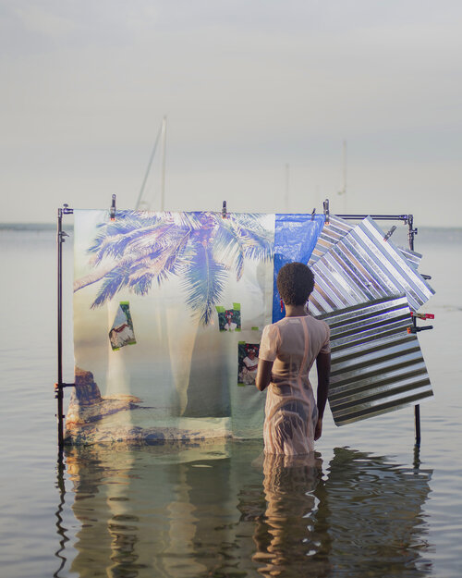
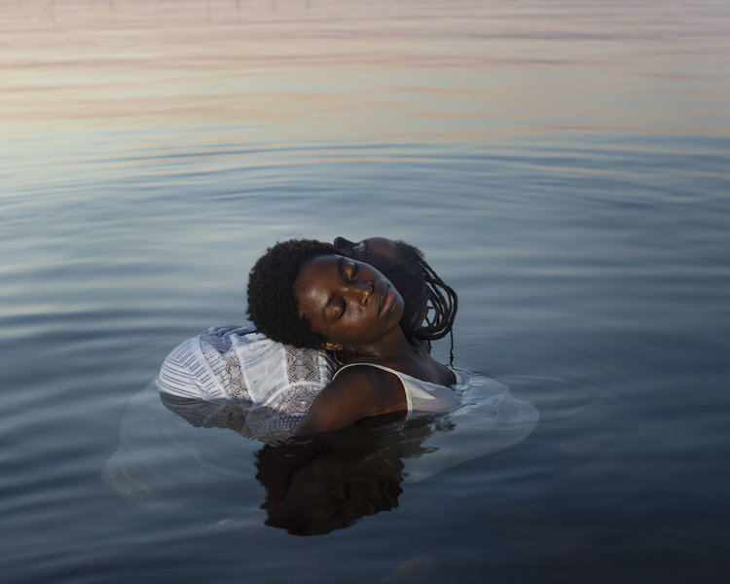
Brainstorm: What is the artist trying to say about identity in the photographs below?

Slide 10
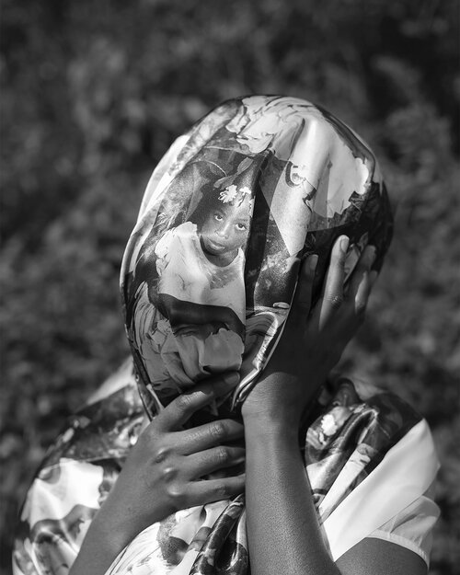

Slide 11
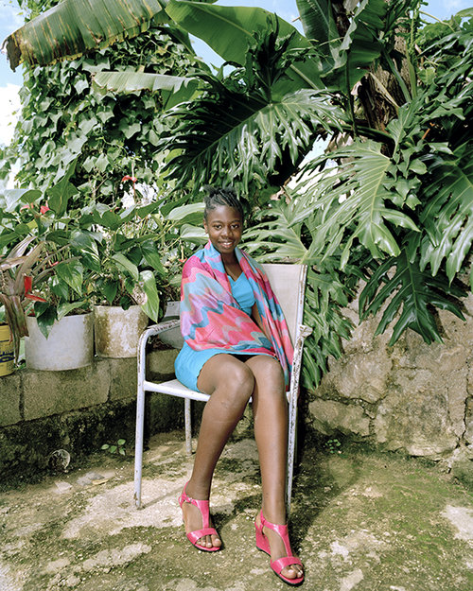
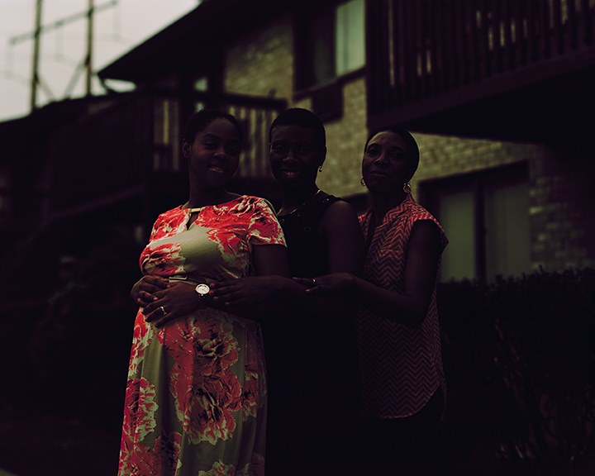

Slide 12
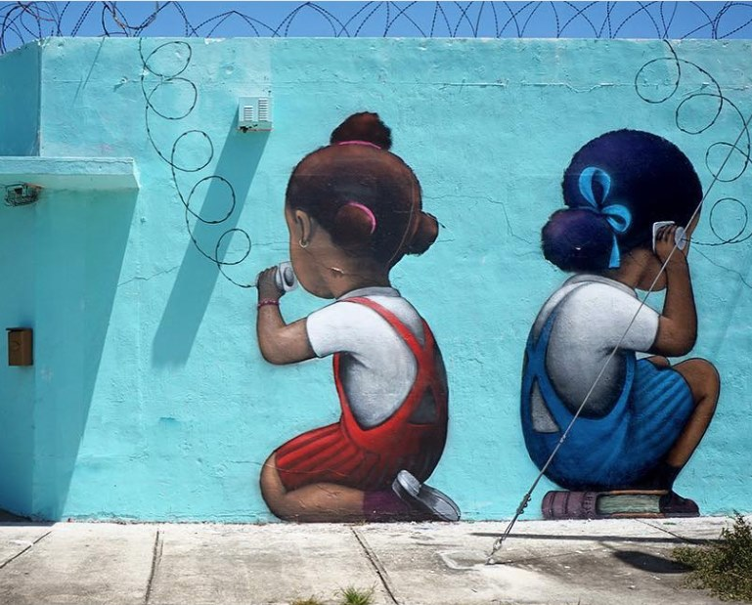
Murals: The artistic souls of communities

Slide 13
Murals are large artistic installations often found on the side of public buildings. They are often used to express the identities of the communities they represents. Sometimes murals are created by professional artists. Often murals are created by local community members.
Below are some murals found in Little Haiti. Let's connect - what do you see expressed in the murals below and throughout this presentation that connect with the visual language in photographs by Widline Cadet? Are there any similarities in the stories of identity?
Remember- visual language is another way of saying "what is the image trying to say?"

Slide 17
Your story of identity and community
Your task:
Think about your self identity and community identity. Remember - your identities probably interact with each other and your community. Take a moment to brainstorm!
Now it is your turn to express your identities through art! Create a mural that tells your story (visual language) of self identity and your community.

