Slide 1

Pew Center, 2018
Notes:
Image retrieved from Pew Center (2018) http://www.pewinternet.org/2018/07/11/activism-in-the-social-media-age/

Slide 2
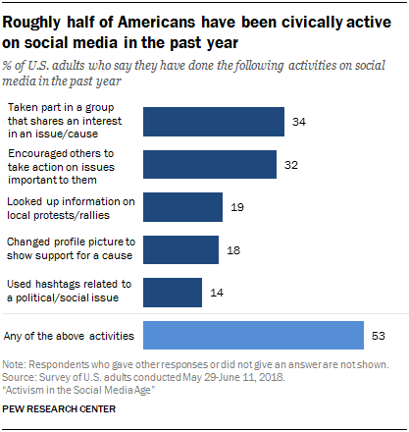
=
Notes:
Image retrieved from Pew Center (2018) http://www.pewinternet.org/2018/07/11/activism-in-the-social-media-age/

Slide 3
Question
How can artwork be used on social media platforms to educate others on socio-political issues and support social activism?

Slide 4
Questions
Is this social activism?
Is this artwork?
Notes:
Tell students you will show them a series of images and ask them if the image is social activism and if the image is artwork. They are to put their thumb up if “yes”, down if “no”, and sideways if “unsure”.
Proceed through slides 4-9 allowing students a moment to study the photograph and text or just the text then ask both questions and take note of their responses.

Slide 5
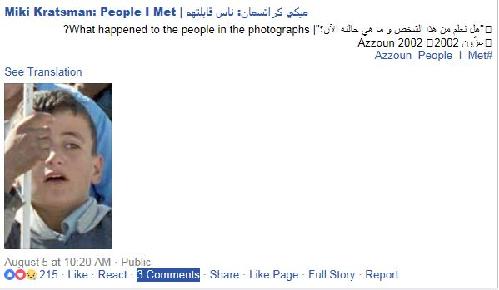
Notes:
Notes for Teacher:
Screenshot of one of the pictures. Above each picture, Kratman asks, “What happened to the people in the photograph?”

Slide 6
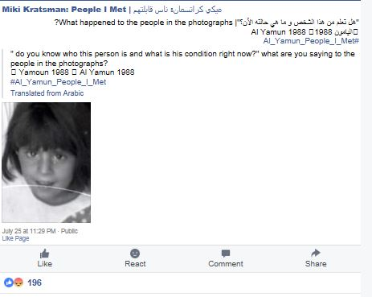
Notes:
Notes for Teacher:
Screenshot of one of the pictures. Above each picture, Kratman asks, “What happened to the people in the photograph?”

Slide 7
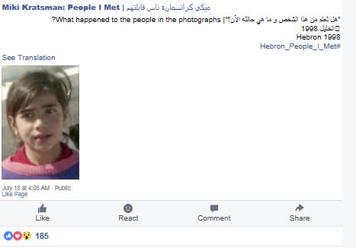
Notes:
Notes for Teacher:
Screenshot of one of the pictures. Above each picture, Kratman asks, “What happened to the people in the photograph?”

Slide 8
Notes:
Comment on Text Wall at an art exhibition of this work.

Slide 9
Notes:
Comment on Text Wall at an art exhibition of this work.

Slide 10
ميكي كراتسمان: ناس قابلتهم
“People I Met”
Miki Kratsman

Slide 11
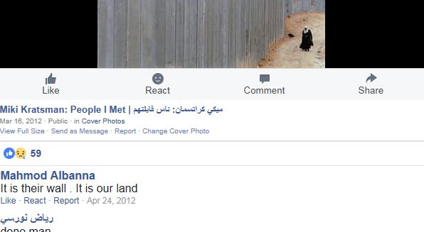
Facebook Site
Notes:
Notes for Teacher:
Since 2011, Kratsman has uploaded thousands of images of Palestinians he has met and photographed to Facebook (https://www.facebook.com/kratsman.people.i.met/?fref=ts). The site includes photos, comments, etc.

Slide 12
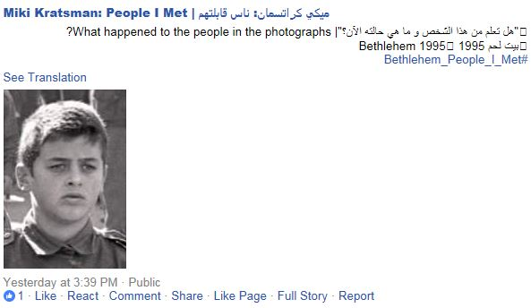
“What happened to the people in the photograph?”
Notes:
Notes for Teacher:
Screenshot of one of the pictures. Above each picture, Kratman asks, “What happened to the people in the photograph?”

Slide 13
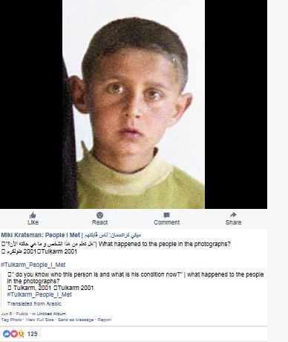
Notes:
Notes for Teacher:
Screenshot of one of the pictures on Facebook

Slide 14
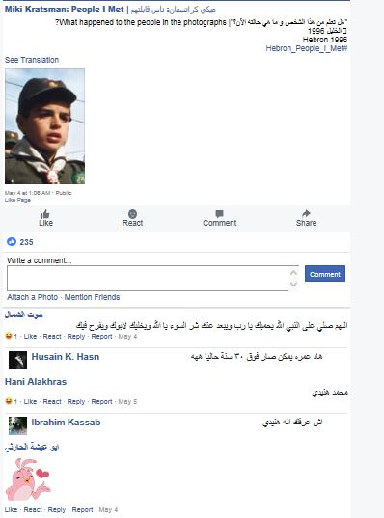
Notes:
Notes for Teacher:
Screenshot of one of the pictures on Facebook

Slide 15
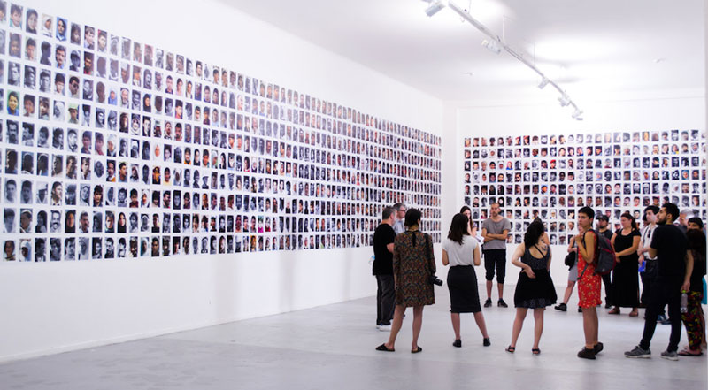
Miki Kratsman, People I Met (installation view), Museo de Arte Contemporaneo, Santiago, Chile. Photo: MAC Quinta Normal.
Notes:
People I Met Project-Miki Kratsman
Notes for Teacher:
People I Met is a series of images that show the lives of Palestinians in the occupied territories, captured over Miki Kratsman’s decades-long photography career working in Gaza and the West Bank. The images, which exist as cropped portraits on a Facebook page, are isolated from their original frame and context. The faces are uploaded with just the date, location and Kratsman’s simple question is asked on Facebook: “What happened to the people in the photographs?” The answers vary; some of these non-combatants have already died: wanted, by-passers, shot with precision (target killings) by employing some of the most advanced military technology that differentiates between one and the other, or in any other conflict-related situation.
The photographs are 'bad', 'cutout', 'taken by', and 'pasted on'. They are kind of an insult to the sharp and bright fetishism of photography as we know it. Kratsman points out to a fictitious subjectivity. These are classic 'missing persons' photographs; those that are pointed at a partially erased inventory list. The portraits, of people living or dead, are individually a world of its own for their relatives, yet nothing to those who want them dead. Kratsman brings this dissonance to his Facebook page. Facebook, if you will, is the tool-box, the workshop. They are precisely what they are: questions that arise from representation, regarding the culture of representation and the ever-growing distance between 'life' and us.
Except above taken from: Chelouche Gallery for Contemporary Art, Tel Aviv, Israel

Slide 17
Think-Pair-Share
Is there a socio-political issue Kratsman is trying to convey? If yes, what is the socio-political issue? How do you know?
Is this social activism? Why? Why not?
Why do you think Kratsman uses a social media platform such as Facebook to post pictures of Palestinians living in occupied territories?

