Slide 1
Seeds of Resistance: Caribbean Resistance Through Time

Slide 2
Think-Pair-Share
What do you see?
What could this be?
Where could it be?

Slide 3
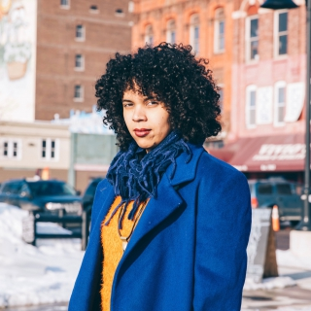
Artist: Joiri Minaya
Title: “The Cloaking of the statues of Ponce de Leon at the Torch of Friendship and Christopher Columbus behind the Bayfront Park Amphitheatre in Miami, Florida, 2019”

Slide 4
About Joiri Minaya
Dominican-American artist; b. 1990
Lives between the U.S. & the D.R.
Context impacts subjectivity
Her work centers on representation, identity constructions, gender roles, migration, and nature
Considers both the personal and larger transcultural and historical frames
Notes:
Living between the United States and the Dominican Republic…has made Minaya aware of her own difference and subjectivity depending on context. Influenced by this, her work meditates on representation, identity constructions, gender roles, migration and nature from a personal place but also through larger transcultural and historical frames.

Slide 5
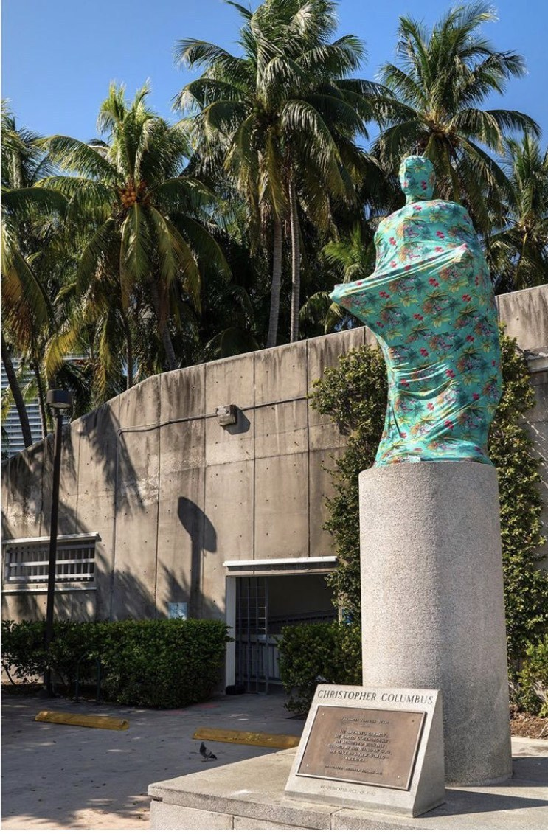
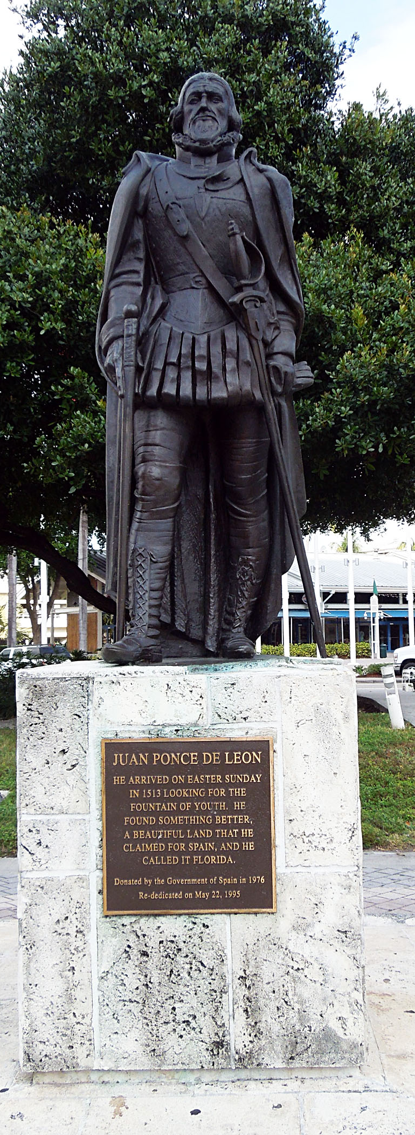
Original monuments vs
The Cloaking

Slide 6
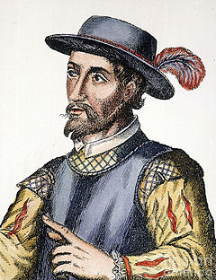
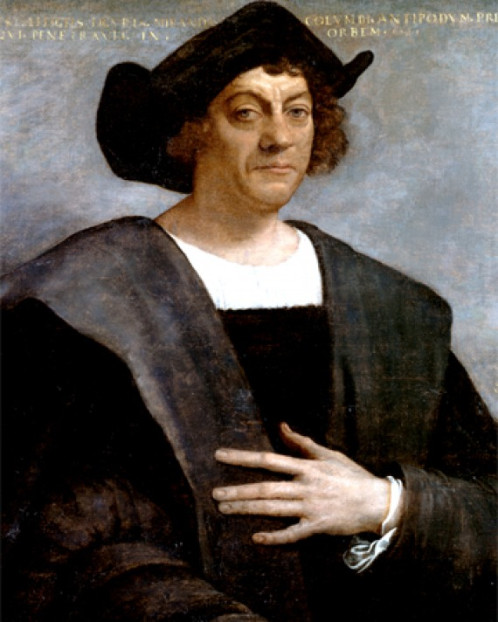
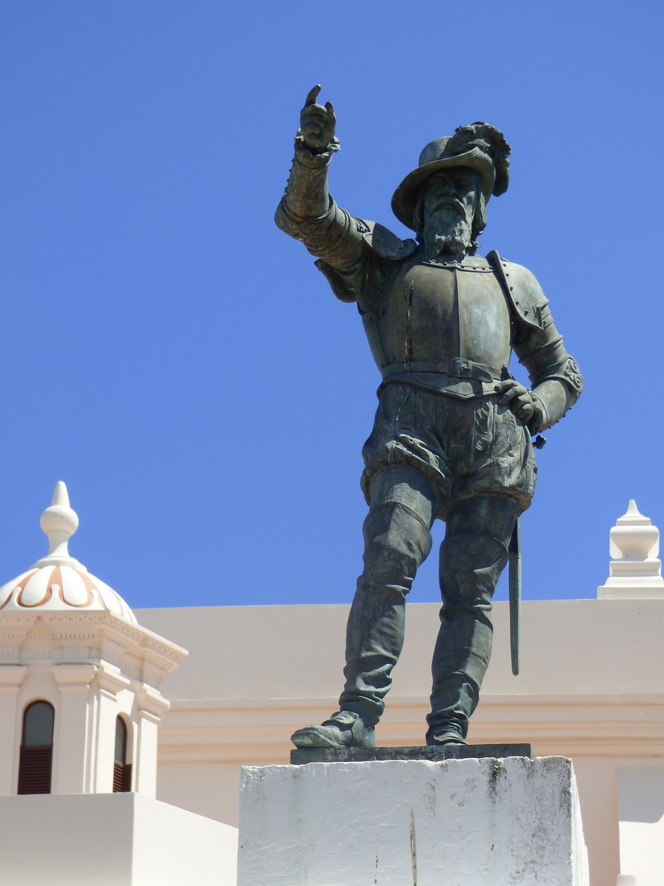
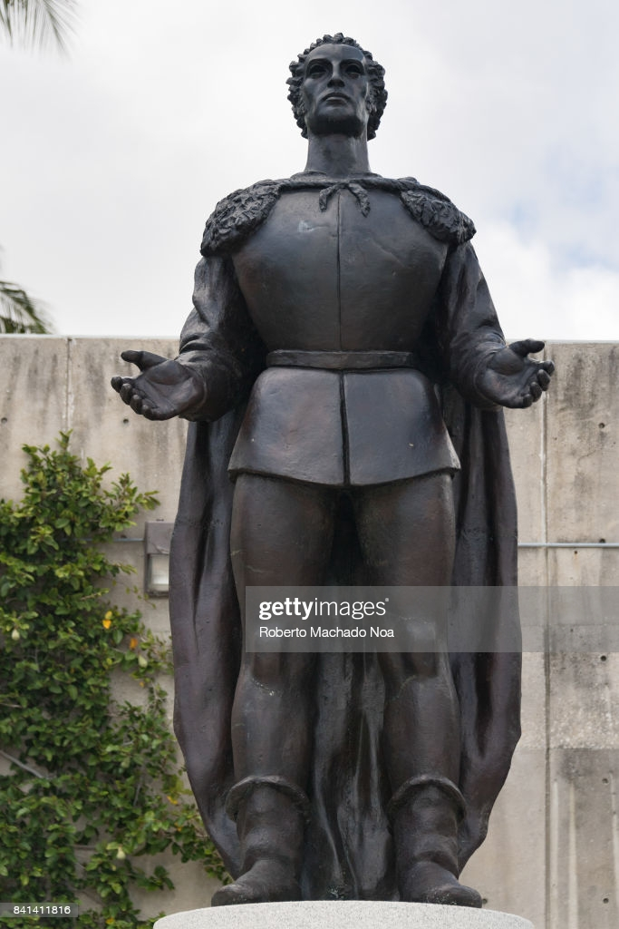
Vocabulary Check
Christopher Columbus: 1st European to sail the Atlantic Ocean and arrive in the Americas. Brought disease to the Indigenous peoples, decreasing the Indigenous population by 95%
Juan Ponce de León: Spanish conquistador who led the first European exploration into Florida. Later became the first governor of Puerto Rico. Violently crushed Indigenous American (Taíno) rebellions
Monument: a statue made to remember a famous or notable person or event
Ponce de León Christopher Columbus

Slide 7
Discussion Questions:
Why are there monuments to Columbus and Ponce de León?
What do monuments say about society and what that society values?
Why would somebody want to cover a monument of Columbus and Ponce de León?

Slide 8
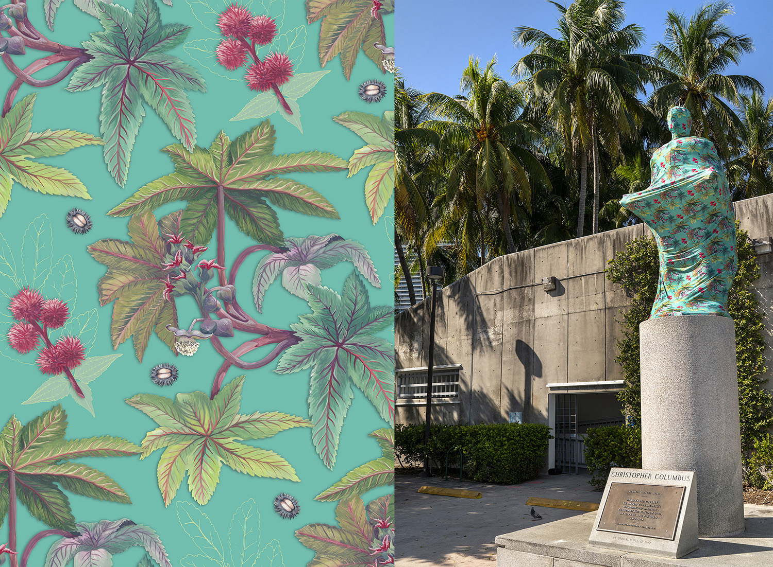
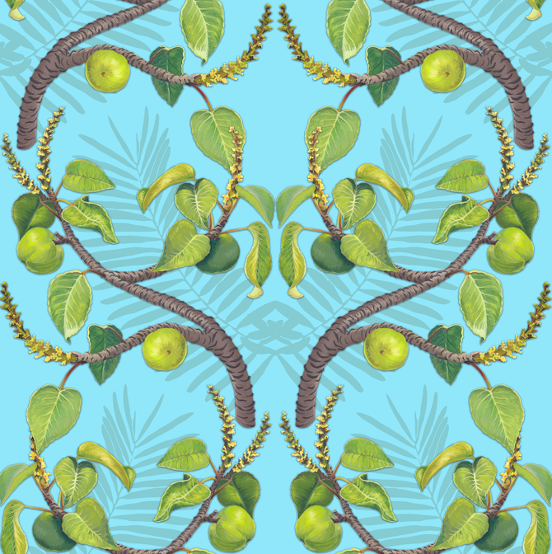
Now we know what the monuments are….
What is covering them?
Do you think the design is important?
What about the kind of fabric used?

Slide 9
“The spandex coverings blurred the detailed bronze memorials into amorphous, strange forms, while calling attention to their presence in the city through colorful, hyper-tropical patterns.”
Jori Minaya

Slide 10
“Plants of Resistance”
Minaya created original tropical prints with allegorical designs symbolizing untold narratives of colonization.
What is colonization? Can you give examples?
What are “untold narratives”? Why are they important to learn about?

Slide 11
“Plants of Resistance”
For the Columbus statue…
“I was looking at plants used in Native American and Black traditions as metaphors of resistance, plants with a poison-healing or poison-defense duality, and traditions of purging, despojo, cleansing, casting evil spirits away or protection.“
- Joiri Minaya
Notes:
A “despojo” is a ritual or spiritual cleansing that casts away evil spirits or negative energy.

Slide 12
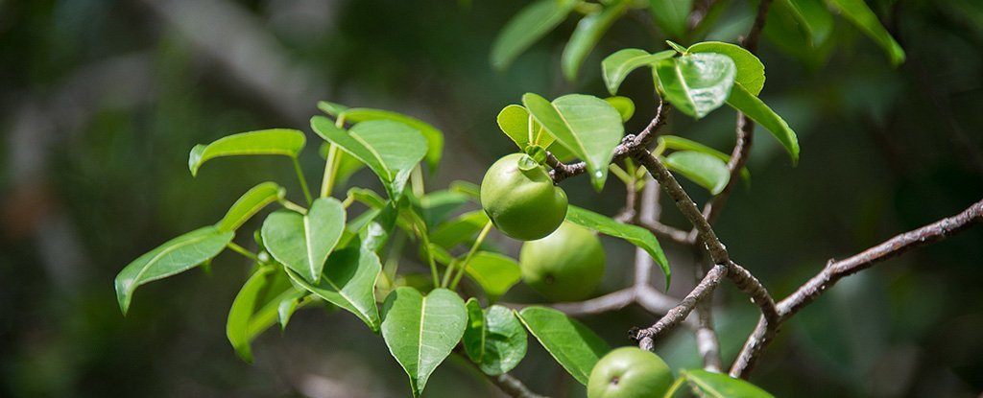
“Plants of Resistance”
For the Ponce de León monument…
Manchineel tree: most dangerous in the world
The Calusa: Native Americans living in southwest Florida who used this tree’s poison to kill Ponce de León
Notes:
During Ponce de León’s 1521 voyage to Florida, he landed near Charlotte Harbor. He was wounded by an arrow during a Native American attack; the arrow tip was likely carrying the poison from a manchineel tree. He died after returning to Cuba.

Slide 13
“Plants of Resistance”
Discussion Questions:
Why would Minaya use the Manchineel tree in her design for the cloak of Ponce de Leon?
How would using these plants for a cloak be a form of resistance?

Slide 14
“Plants of Resistance”
Minaya focuses on using art to show the untold story of colonization and resistance.
What is resistance? What are examples of resistance?
What are ways people have resisted oppression before?
What is colonization? What are examples of colonization?
Notes:
The image is from the Standing Rock protests in the USA (April 2016 – February 2017)

Slide 15
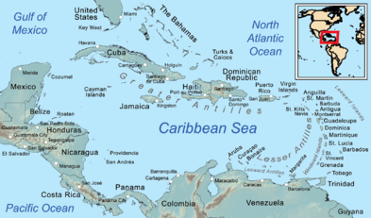
Resistance in the Caribbean
Caribbean: islands between North and South America where millions of people live
Islands include: Haiti, Dominican Republic, Cuba, Puerto Rico, Jamaica, and many more
What do you think of when you think of the Caribbean?
Notes:
Show students the map of the Caribbean. Ask them what they think of when they think of the Caribbean. Allow students to answer the question before going onto the next slide. Explain that many people think of beaches and island life. However, that is not all that the Caribbean is. It has a rich history that is often overlooked by tourists.

Slide 16
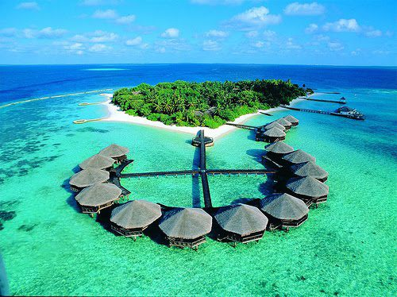
What do you think of when you think of the Caribbean?
People usually think of this.

Slide 17
Resistance in the Caribbean
The Caribbean is beautiful but it is also a place of colonization and resistance.
Ever since Columbus sailed into the Caribbean in 1492, the Caribbean people have been fighting colonization!

Slide 18
Resistance in the Caribbean:
RELIGION
Notes:
Artist: Dieudonne Cedor Ceremony at the Bois Caïman
https://sites.duke.edu/blackatlantic/sample-page/storytelling-and-representation-of-bois-caiman/painting-and-bois-caiman/

Slide 19
Resistance in the Caribbean: Religion
Syncretic religions: many enslaved Africans kept practicing their traditional African religions alongside the Christian religion of the colonizers
Examples: Santería (Cuba), Voodoo (Haiti), Ju-Ju (Bahamas), Espiritismo (Puerto Rico)… all of these are a mixture of Christian and West African religions

Slide 20
Resistance in the Caribbean: Religion
Their religion was also used as a rallying cry for rebellion!
Many religious leaders helped start rebellions.
Example: Bois Caiman Voodoo ceremony helped start the Haitian Revolution
Notes:
Artist: Nicole Jean-Louis Bwa Kayiman Haiti 1791
Even though the religions were often outlawed, enslaved Africans continued to practice their traditional religious ceremonies.

Slide 21
Resistance in the Caribbean: Religion
Even though the religions were sometimes outlawed, enslaved Africans continued to practice their traditional religions.
Discussion Questions:
How was religion used to resist oppression?
How is practicing an outlawed religion a form of resistance?

Slide 22
Resistance in the Caribbean:
Maroon Societies
Notes:
http://news.bbc.co.uk/2/shared/spl/hi/pop_ups/07/americas_enl_1174490555/html/1.stm
Jamaican Maroons wait to ambush an approaching British military column circa 1795by J. Bourgoin

Slide 23
Resistance in the Caribbean: Maroons
Maroons: enslaved Africans who escaped slavery and created their own societies in the wilderness of the Caribbean
If caught, the Maroons would have been sent back to the plantations or killed
The Maroon societies in Jamaica were the most prolific and famous

Slide 24
Resistance in the Caribbean: Maroons
Nanny: a Jamaican Maroon leader who helped defeat the British in the 1730s
Used guerrilla warfare to surprise British troops
However, after the war, the Maroons agreed not to allow any more runaway slaves into their territory in exchange for being left alone
Notes:
Leonard Parkinson, Maroon Leader, Jamaica, 1796

Slide 25
Resistance in the Caribbean: Maroons
Discussion Questions:
What is happening in this image?
What do you see that makes you say that?
What else can we find?

Slide 26
Resistance in the Caribbean: Maroons
Le Marron Inconnu (1967) by Albert Mangonès
Monument dedicated to the Maroons in Haiti
Discussion Questions:
Why would there be a monument to the Maroons?
What does this monument say about the society of Haiti?
Notes:
"The Unknown Maroon“: the artist created the sculpture of “The Unknown Maroon” to commemorate the rallying cry that sparked the Haitian Revolution and the abolition of slavery.

Slide 27
Resistance in the Caribbean:
Rebellion
Notes:
Attack and take of the Crête-à-Pierrot (March 24, 1802) by Auguste Raffet

Slide 28
Resistance in the Caribbean: Bussa’s Rebellion
Bussa was an enslaved African who led 400 people in a rebellion against plantation owners in Barbados
Even though the rebellion was defeated, it inspired many rebellions in the British-owned colonies
Notes:
John Carter Brown Library
Account of an insurrection of the negro slaves in the colony of Demerara, which broke out on the 18th of August, 1823. (Retreat of Lt. Brady) Large group of slaves force the retreat of European soldiers. Includes canal, boat, drawbridge, dwellings, guns or muskets, flag, hogs, pigs, dogs, and bayonnets.

Slide 29
Resistance in the Caribbean:
Bussa’s Rebellion
The Emancipation Statue by Karl Broodhagen
This is a monument to Bussa, located in Barbados
Discussion Questions
Why would there be a monument to a “failed” rebellion?
Why would a “failed” rebellion inspire others to resist oppression and slavery?
Notes:
https://barbados.org/bussa.htm#.X_s6E9hKiUk

Slide 30
Resistance in the Caribbean: Curaçao Slave Revolt of 1795
In the Dutch colony of Curaçao, an enslaved man named Tula led a month-long rebellion against the Europeans
After a month of guerrilla war, Tula and his rebels were betrayed and captured. Tula was executed
In 1863, slavery was finally abolished in Curaçao
Notes:
The image is a monument to Tula in Curacao today.
https://face2faceafrica.com/article/the-tula-slave-revolt-of-1795-that-led-to-better-treatment-of-slaves-in-curacao

Slide 31
Resistance in the Caribbean:
The Haitian Revolution
Haiti was a French colony that produced more than half of the world’s sugar
It was known for its harsh treatment of enslaved Africans
1791-1804: Haitian Revolution
Notes:
Battle at "Snake Gully" in 1802

Slide 32
Resistance in the Caribbean:
The Haitian Revolution
Bois-Caiman, a Voodoo ceremony, helped start the revolution
Led by Toussaint Louverture, the Revolution was bloody and fierce
Many enslaved Africans rose up and killed the white plantation owners and burned down the sugar fields where they worked
Notes:
Artist: Dieudonne Cedor Ceremony at the Bois Caïman
https://sites.duke.edu/blackatlantic/sample-page/storytelling-and-representation-of-bois-caiman/painting-and-bois-caiman/

Slide 33
Resistance in the Caribbean:
The Haitian Revolution
After many years of fighting, L’Ouverture was captured by the French and died in prison
A year after his death, Haiti finally won their Revolution and enslaved Africans were finally free
Notes:
Gen. Toussaint L’Ouverture (1743–1803), detail, artist unknown.

Slide 34
Final Questions
What are some ways people resisted colonization in the Caribbean?
How can art be a way to resist oppression and celebrate resistance?

Slide 35
Final Assessment
Create a cloth pattern that explains a resistance movement you learned about today, or one you are interested in.
It does not have to include plants, but it does need to have a key that explains why you used specific images.

