Slide 1
The 1950s
& The Rise of Pop Culture

Slide 2
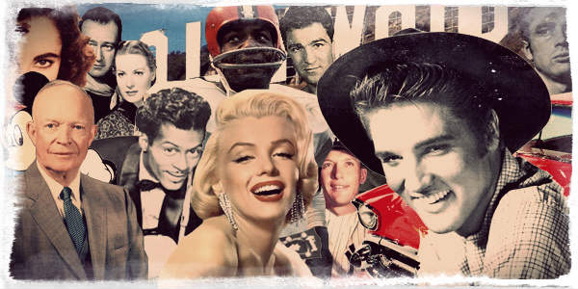
What Do You Know About The 1950s? (video)
Notes:
Video retrieved from: http://www.history.com/topics/1950s/videos/1950s
1950’s Collage image retrieved from: https://www.retrowaste.com/1950s/
Ask students, “What comes to mind when you think about the 1950s?” Have students watch the video and take note of how many of their thoughts are depicted in the video. Video is linked in the ppt or can be found at http://www.history.com/topics/1950s/videos/1950s

Slide 3
What Do You Know About The 1950s? (timeline)
Notes:
Timeline located at: https://www.thoughtco.com/1950s-timeline-1779952
Timeline picture retrieved from: http://keywordsuggest.org/gallery/799083.html
Using the notes on slide 3, go through the timeline and discuss a few events/inventions that occurred each year. Timeline is linked in the ppt or can be found at https://www.thoughtco.com/1950s-timeline-1779952
1950: first credit card, first Peanuts cartoon, first organ transplant, President Truman ordered the building of the hydrogen bomb*, Korean War began, Senator McCarthy’s Communist hunt.
1951: Color television began, Truman signed a peace treaty with Japan ending WWII, Churchill becomes Prime Minister of Britain, the United States ratifies the 22nd amendment limiting the President to two terms in office, and South Africans carry identification cards.
1952: Princess Elizabeth becomes Queen of Britain at age 25, Puerto Rico is named as a self-governing commonwealth of the U.S., Great London Smog of 1952, Seat belts were invented, and the polio vaccine was created.
1953: DNA was discovered, First people to climb to the summit of Mount Everest, frozen tv dinners introduced by Swanson, Joseph Stalin dies, Rosenberg’s executed for espionage.
1954: Brown v. Board of Education made segregation illegal, first atomic submarine was launched, Salk’s polio vaccine massive trial on children, Cigarettes were reported to cause cancer.
1955: McDonald’s founded, Disneyland in California opened, Civil Rights Movement began, Rosa Parks refused to give up her bus seat, Montgomery Bus Boycott
1956: Elvis Presley enters the entertainment scene with his first hit song, “Heartbreak Hotel”, TV remote was invented, Velcro was first used, Suez crisis took place, Warsaw Pack was signed, and Hungarian Revolution exploded.
1957: Launch of Soviet satellite Sputnik, establishment of the European Economic Community, Malaysia and Ghana gain independence from the United Kingdom, and Dr. Seuss published “The Cat in the Hat”
1958: Establishment of NASA, Hula hoops was invented, microchip was invented, creation of legos, and Chinese leader Mao Tse-tung launched the “Great Leap Forward”
1959: Fidel Castro became dictator of Cuba, Alaska and Hawaii are admitted as the 49th and 50th states in the U.S.. Sound of Music opened on Broadway

Slide 4
1950s Pop Culture (video)
Notes:
Fifties Pop Culture Video retrieved from: https://www.youtube.com/v/YSzX5PgQc80
Engage students in a discussion of pop culture. Ask questions such as:
What is pop culture?
How would you define pop culture?
Give an example of pop culture?
Then show the class a video on 1950s pop culture. The video is linked in the ppt or can be found at https://www.youtube.com/v/YSzX5PgQc80

Slide 5
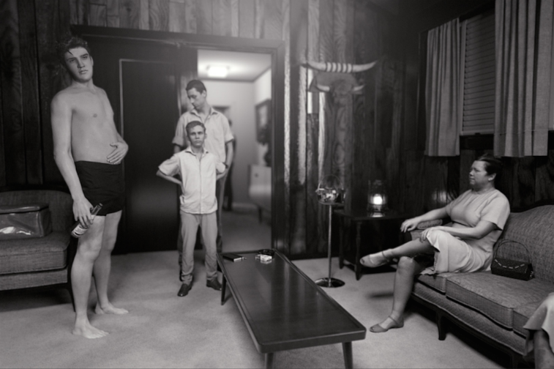
Video
Notes:
Image Retrieved from: http://davidclaerbout.com/KING-after-Alfred-Wertheimer-s-1956-picture-of-a-young-man-named
Ask students to examine the photograph of the screen. Ask:
What’s going on in this picture?
What so you see that makes you say that?
What more can we find?
Tell students that the photograph is Alfred Wertheimer’s 1956 portrait of a young man named Elvis Presley. For many, Elvis is the image that comes to mind when one things of 1950’s pop culture.
Next, show the 11:13 minute video of Claerbout’s 3D work KING, a representation of Alfred Wertheimer’s 1956 portrait of a young man named Elvis Presley found online at: https://vimeo.com/129779229. While video is playing read background and description found online at: http://davidclaerbout.com/KING-after-Alfred-Wertheimer-s-1956-picture-of-a-young-man-named

Slide 6
Elvis in the Beginning: Photographs by Alfred Wertheimer (slideshow)
Notes:
Pass out copies of the Times article titled, “Elvis in the Beginning: Photographs by Alfred Wertheimer” to students. Times article located online at: http://time.com/3797423/elvis-in-the-beginning-photographs-by-alfred-wertheimer/. Have volunteers take turns reading the article aloud. After the article is read, have volunteers read the captions to a few of the 26 images of Elvis taken by Wertheimer. The slideshow is linked in the ppt or can be found at http://time.com/3797423/elvis-in-the-beginning-photographs-by-alfred-wertheimer/

Slide 7
Heartbreak Hotel (Video)
Notes:
Have students watch a video of Elvis performing Heartbreak Hotel, his 1956 hit. Video is linked in the ppt or can be found at: https://video.search.yahoo.com/yhs/search?fr=yhs-Lkry-SF01&hsimp=yhs-SF01&hspart=Lkry&p=elvis+performing+heartbreak+hotel#id=2&vid=c27ad68f5c743a8942e1282bd282beb2&action=click

Slide 8
Pop Culture 1950s to Today
In what ways do you think pop culture of the 1950s, primarily Elvis Presley, influenced society in the 1950s?
In what ways do you think pop culture of the 1950s has influenced society today?
What do you think music would be like today if there was never the 1950s rise in pop culture or Elvis Presley?
Who is today’s pop culture icon “Elvis Presley” and what influence has this person had on society?
Notes:
Engage students in a conversation on pop culture from the 1950s to today through a Think-Pair-Share activity (preview video on think-pair-share if unfamiliar with this strategy located at: https://www.teachingchannel.org/videos/think-pair-share-lesson-idea) based on the following questions:
In what ways do you think pop culture of the 1950s, primarily Elvis Presley, influenced society in the 1950s?
In what ways do you think pop culture of the 1950s has influenced society today?
What do you think music would be like today if there was never the 1950’s rise in pop culture or Elvis Presley?
For a closing activity, have students engage in a Commit and Toss (preview video on commit and toss if unfamiliar with this strategy located at: http://www.youtube.com/watch?v=cvpsBy4A0Zk) based on the following question:
Who is today’s pop culture icon “Elvis Presley” and what influence has this person had on society?
vid=c27ad68f5c743a8942e1282bd282beb2&action=click

Slide 9
Pop Culture 1950s to Today
Determine what you believe best represents pop culture of the 1950s and trace its influence on society from the 1950s to today.
Create a product that highlights the ways this aspect of pop culture has evolved and influenced society over time (e.g., slideshow, video, song, artwork).
Notes:
Individually, have students determine what s/he believes best represents pop culture of the 1950s. Have students research this aspect of pop culture and trace its influence on society from the 1950s to today. The final product is to create a product (differentiation of product; final product could be a slideshow, video, song, piece of artwork) that highlights the ways the aspect of pop culture the student has selected has evolved and influenced society over time.

