Slide 1
Past/Present: Exploring a new era in Cuba through the artwork of Glexis Novoa

Slide 2
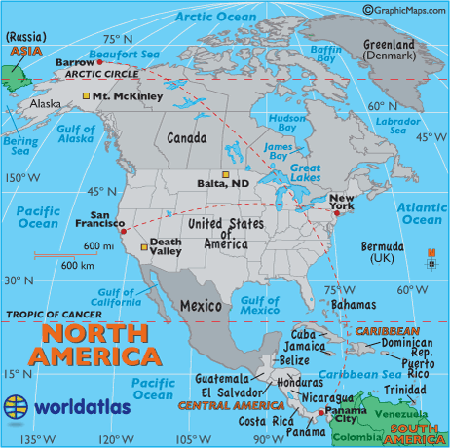
Notes:
Can you add the source of these maps here in the Notes View – slides 2 thru 4?

Slide 3
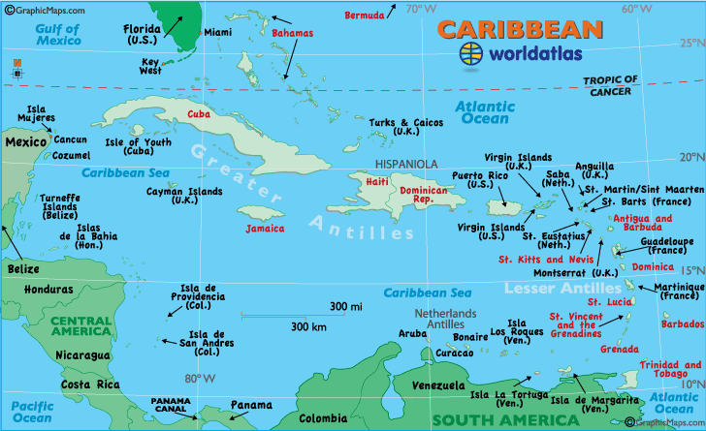
Notes:
http://www.emapsworld.com/cuba-location-map-in-north-america.html

Slide 4
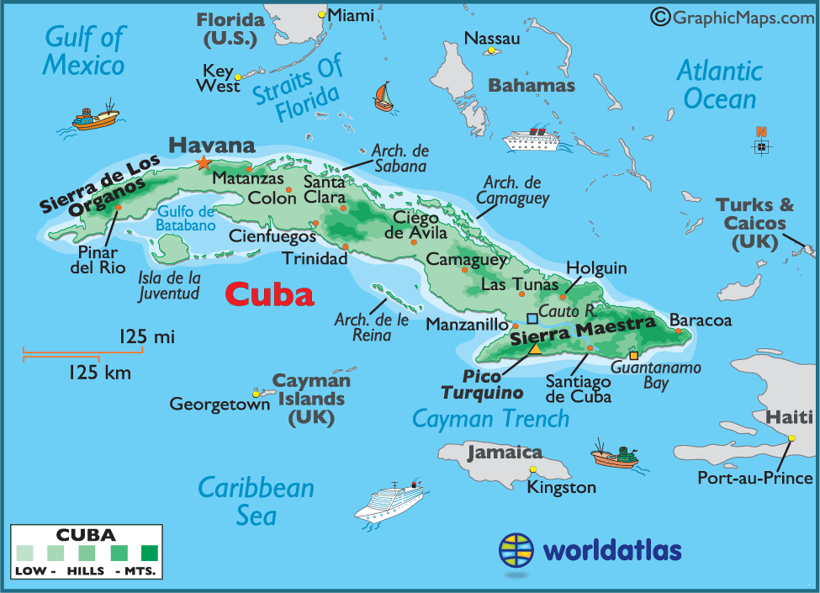

Slide 5
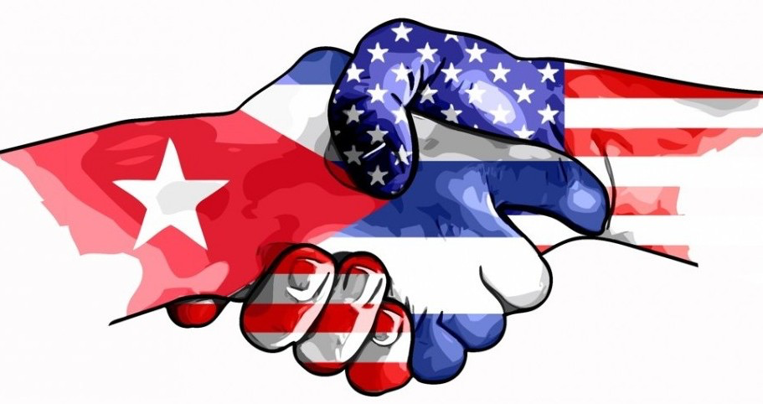
Timeline U.S. – Cuba Relations
Why has the U.S. been involved in Cuba’s affairs?
What are some major events in the relations between the two countries?
What role did the Soviet Union and the Cold War play in U.S. relations with Cuba?

Slide 6
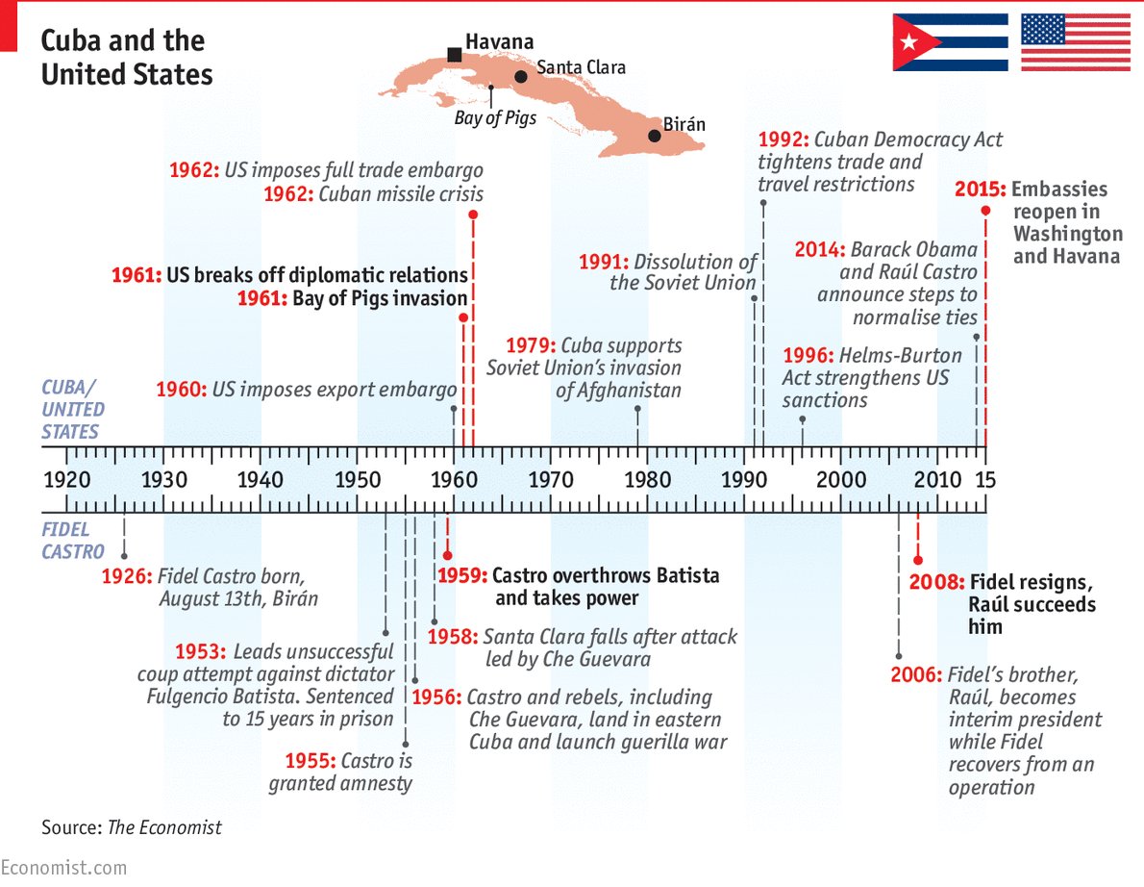
Notes:
Image source: https://www.economist.com/news/21659470-opposition-america-threatens-fraught-relations-between-two-countries-cuban-timeline

Slide 7
Glexis Novoa
Lives and works in between Miami and Havana
Well known for graphite drawings and paintings on canvas
Born in 1964, he has used art as means of social and political expression throughout various periods in Cuban history

Slide 8
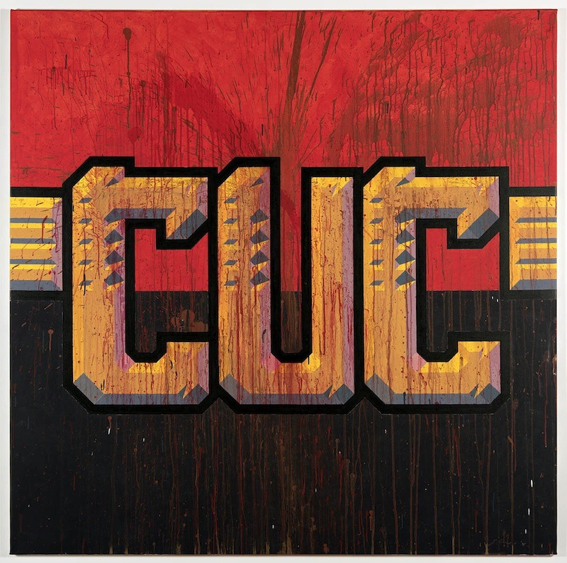
Notes:
There are two currencies in Cuba, the Cuban Peso (CUP) and the Cuban Convertible Peso (CUC), neither of which are exchangeable on foreign markets. Most Cubans are paid in CUP, while CUC is worth 25 times as much. CUCs are purchased with foreign currency, and are worth 25 times CUPs; they are used by tourists and by Cubans with access to foreign currency. Most Cubans are paid in CUPs, equivalent to about $20 a month.
https://www.economist.com/blogs/americasview/2013/10/cubas-currency

Slide 9
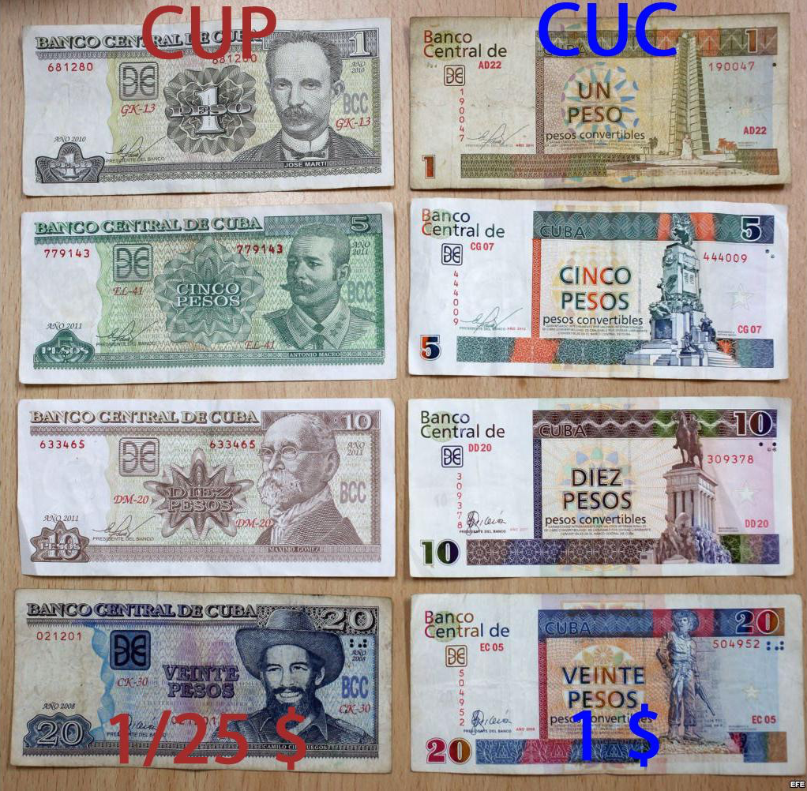
Cuban Currencies
Cuban peso (CUP) & Cuban convertible peso (CUC)

Slide 10
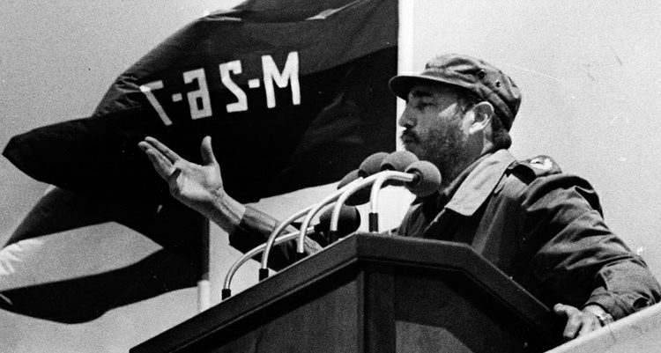
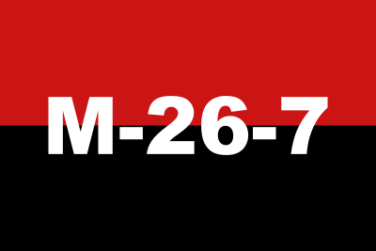
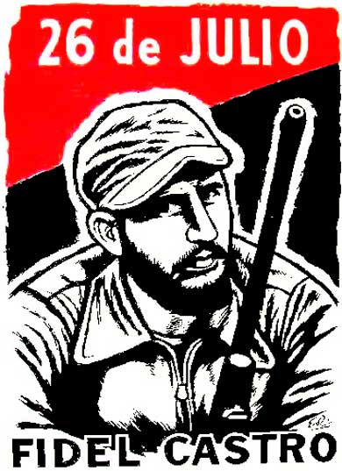
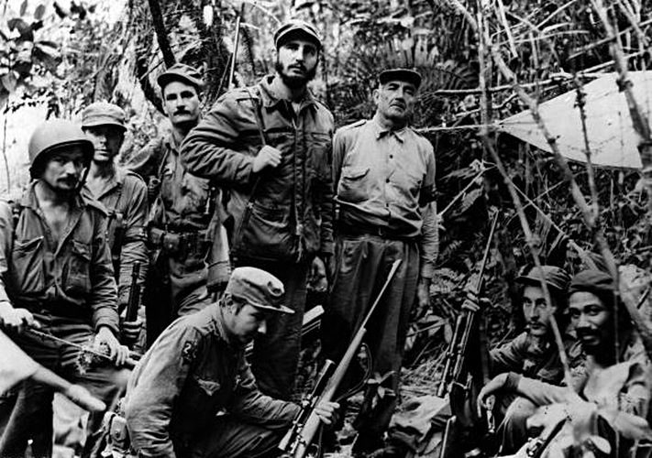
Movement of the 26th of July
Notes:
Ditto

Slide 11
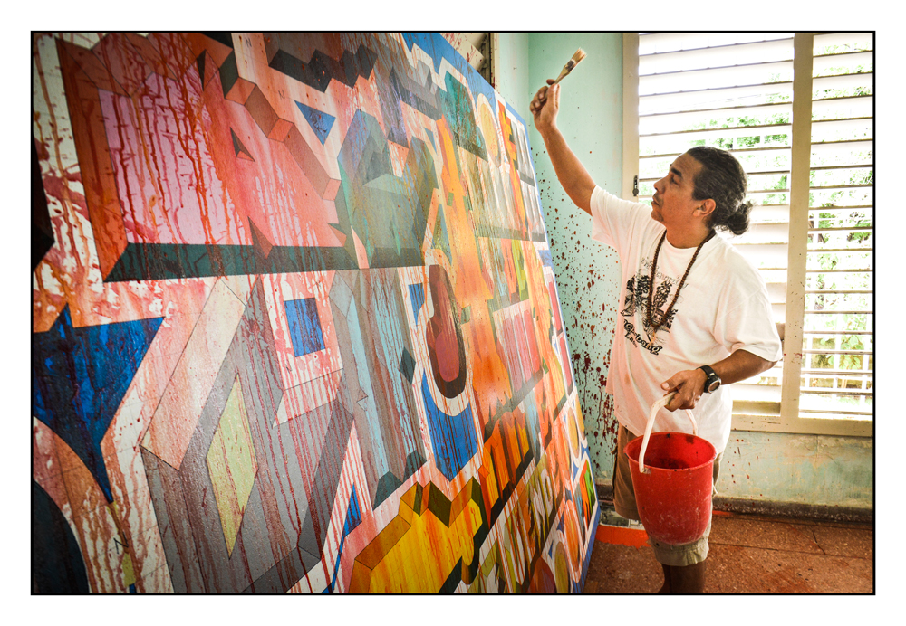
Glexis Novoa on his work from the 1980s…
“We wanted to be revolutionaries in the way we tried to fix social and political problems through our art. We were trying to create a voice through our art.”
What social or political problems might be addressed by CUC?
Do you think that art can be revolutionary? Explain your response.

