Slide 1
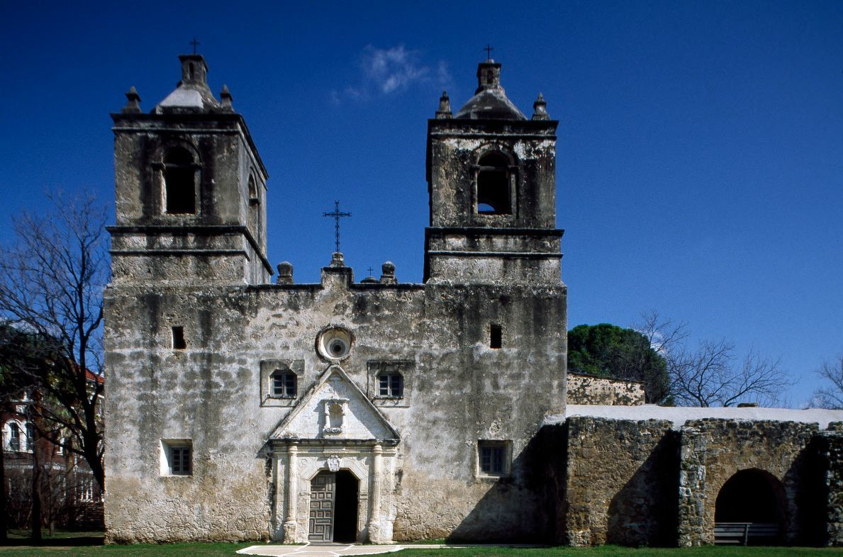
Mexicans and Americans: A Shared History and Culture
Notes:
Image: Mission Concepción, one of five missions in Old San Antonio, Texas
Source: https://www.loc.gov/teachers/classroommaterials/presentationsandactivities/presentations/immigration/alt/mexican2.html

Slide 2
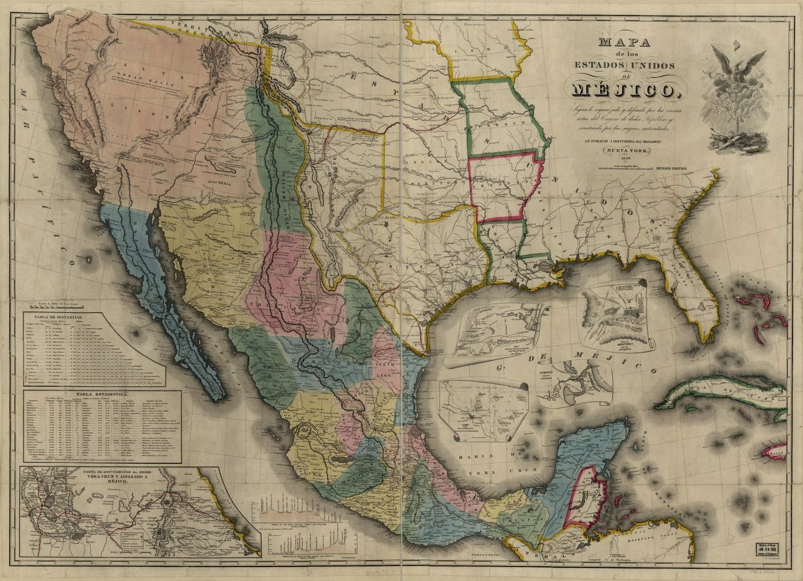
Notes:
Teacher note: This map was published in 1847. This captures the land that belonged to Mexico prior to the conclusion of the Mexican-American War (1846-1848.)
Questions:
After allowing students a few minutes to view and study the map, ask:
(Observe)
What do you notice first?
What on the map looks strange or unfamiliar?
What place or places does the map show?
What, if any, words do you see?
(Reflect)
Why do you think this map was made?
Who do you think the audience was for this map?
How do you think this map was made?
How does it compare to current maps of this place?
What does this map tell you about what the people who made it knew and what they didn’t?
If this map was made today, what would be different? What would be the same?
(Question)
Invite students to ask questions that lead to more observations and reflections. What do you wonder about... who? • what? • when? • where? • why? • how?
Source: https://www.loc.gov/teachers/usingprimarysources/resources/Analyzing_Maps.pdf
Primary Source Map Image
Title: Mapa de los Estados Unidos de Méjico, California &c. : según lo organizado y definido por las varias actas del congreso de dicha República y construido por las mejores autoridades.
Created / Published: New York, J. Disturnell, 1847.
Source: https://www.loc.gov/resource/g4410.ct000581/?r=-0.16,-0.033,1.267,0.805,0

Slide 3
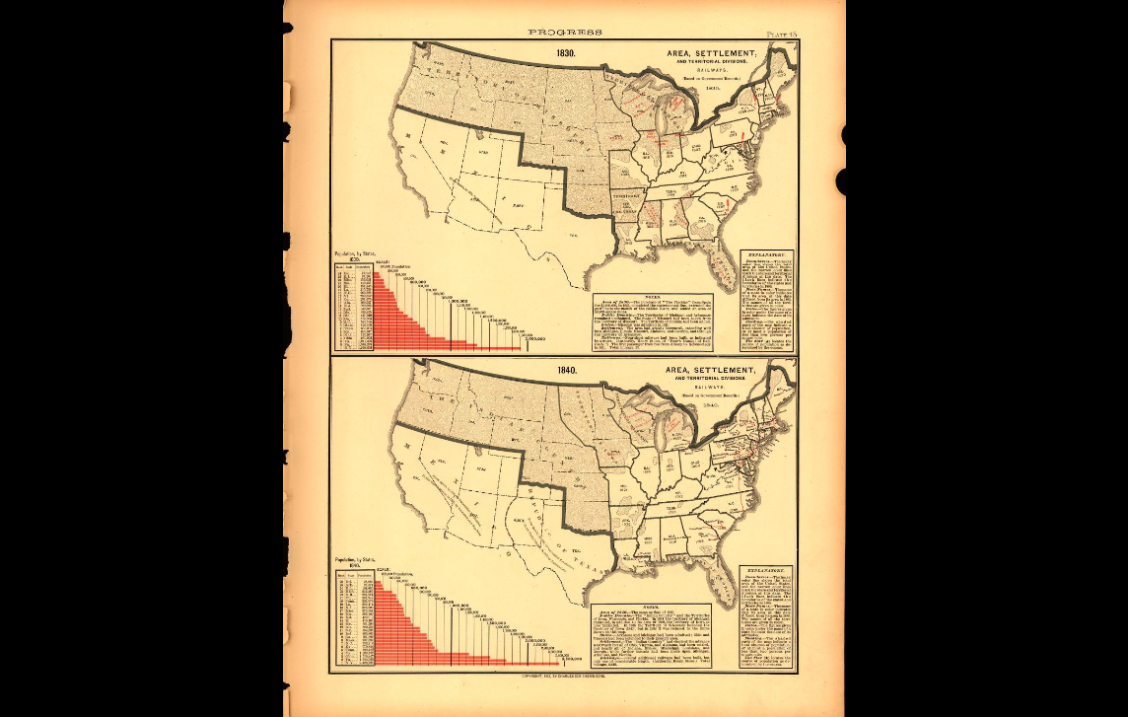
Prior to the Mexican-American War (1846-1848), most of the southwest U.S. belonged to Mexico.
Scribner's statistical atlas of the U.S., Plate 15
Notes:
Source: https://www.loc.gov/teachers/classroommaterials/presentationsandactivities/presentations/immigration/alt/mexican2.html

Slide 4
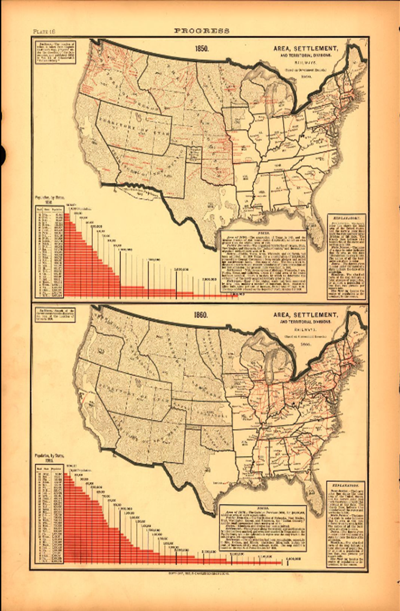
The first Mexicans to become part of the United States never crossed any border. Instead, the border crossed them.
Treaty of Guadalupe Hidalgo (1848): California was ceded to the United States following the defeat of Mexico in the Mexican–American War
Gadsden Purchase (1853): U.S. buys southern Arizona and New Mexico for $10 million.
Almost overnight, thousands of Mexican citizens became residents of the United States.
Scribner's statistical atlas of the U.S., Plate 16
Notes:
Source: https://www.loc.gov/teachers/classroommaterials/presentationsandactivities/presentations/immigration/alt/mexican2.html
Formative Assessment: How do you think the Mexican-American War and the Gadsden Purchase affected settlers in the region?

Slide 5
Kathya Maria Landeros
Notes:
Sources: http://kathyalanderos.com/contact.html & https://www.cpw.org/artist/kathya-maria-landeros/
Background Information.
Contemporary, Mexican-American artist Kathya Maria Landeros focuses her photography on the Mexican-American experience. She draws inspiration from her own family. Landeros writes, “My great-grandfather worked in the mines in Arizona. My grandfather was a Bracero, part of a bilateral government sanctioned agricultural work program. And my grandmother and parents worked as farmhands when they first came to the United States. My family’s legacy of migration has allowed me to better understand the inextricable ties between the two countries and its people, and has also led me to my interest in exploring U.S. to Mexico immigration from the perspective of longstanding Mexican-American communities.”

Slide 6
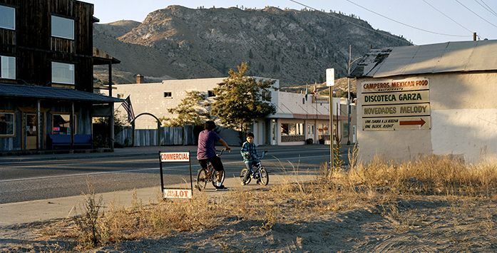
Notes:
http://kathyalanderos.com/west/three.html
Visual Thinking Strategies
Look closely at the picture and think about the following three questions:
What is going on in this picture?
What do you see that makes you say that?
What more can you find?
Primary Source Analysis
Author: Who created the image? What do you know about the author? What is the author's point of view?
Place and time: Where and when was the image produced? How might this affect the meaning of the image?
Prior knowledge: Beyond information about the author and the context of its creation, what do you know that would help you further understand the image? For example, do you recognize any symbols and recall what they represent?
Audience: For whom was the image created and how might this affect the reliability of the image?
Reason: Why was this image produced, and how might this affect the reliability of the image?
The main idea: What is the purpose of the image? What message is it trying to convey?
Significance: Why is this important?
Sources:
https://www.daummuseum.org/learn/vts/
https://secure-media.collegeboard.org/apc/ap05_ushist_greer_2_p_50286.pdf
http://researchguides.library.vanderbilt.edu/c.php?g=68881&p=446169

Slide 7
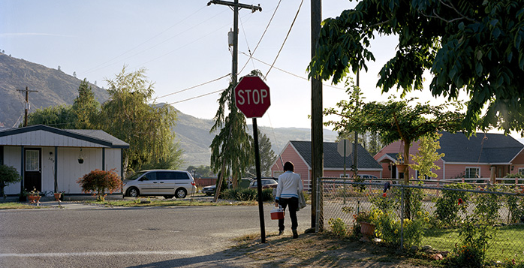
Notes:
http://kathyalanderos.com/west/four.html
Visual Thinking Strategies
Look closely at the picture and think about the following three questions:
What is going on in this picture?
What do you see that makes you say that?
What more can you find?
Primary Source Analysis
Author: Who created the image? What do you know about the author? What is the author's point of view?
Place and time: Where and when was the image produced? How might this affect the meaning of the image?
Prior knowledge: Beyond information about the author and the context of its creation, what do you know that would help you further understand the image? For example, do you recognize any symbols and recall what they represent?
Audience: For whom was the image created and how might this affect the reliability of the image?
Reason: Why was this image produced, and how might this affect the reliability of the image?
The main idea: What is the purpose of the image? What message is it trying to convey?
Significance: Why is this important?
Sources:
https://www.daummuseum.org/learn/vts/
https://secure-media.collegeboard.org/apc/ap05_ushist_greer_2_p_50286.pdf
http://researchguides.library.vanderbilt.edu/c.php?g=68881&p=446169

Slide 8
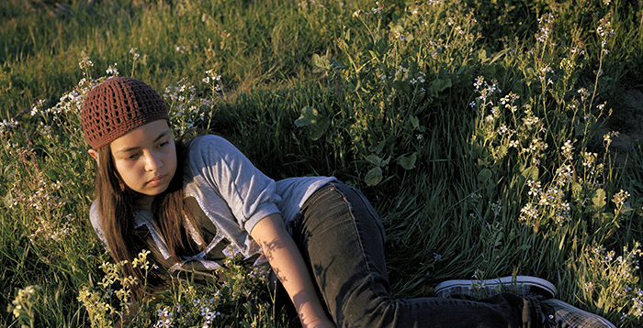
Notes:
http://kathyalanderos.com/verdantland/four.html
Visual Thinking Strategies
Look closely at the picture and think about the following three questions:
What is going on in this picture?
What do you see that makes you say that?
What more can you find?
Primary Source Analysis
Author: Who created the image? What do you know about the author? What is the author's point of view?
Place and time: Where and when was the image produced? How might this affect the meaning of the image?
Prior knowledge: Beyond information about the author and the context of its creation, what do you know that would help you further understand the image? For example, do you recognize any symbols and recall what they represent?
Audience: For whom was the image created and how might this affect the reliability of the image?
Reason: Why was this image produced, and how might this affect the reliability of the image?
The main idea: What is the purpose of the image? What message is it trying to convey?
Significance: Why is this important?
Sources:
https://www.daummuseum.org/learn/vts/
https://secure-media.collegeboard.org/apc/ap05_ushist_greer_2_p_50286.pdf
http://researchguides.library.vanderbilt.edu/c.php?g=68881&p=446169

Slide 9
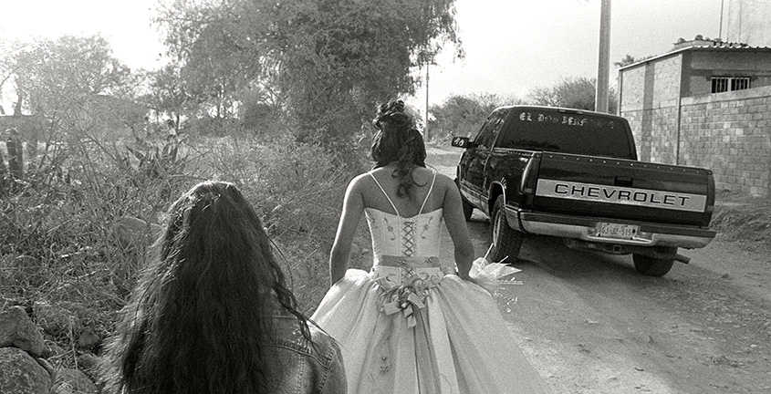
Notes:
http://kathyalanderos.com/tierranuestra/two.html
Visual Thinking Strategies
Look closely at the picture and think about the following three questions:
What is going on in this picture?
What do you see that makes you say that?
What more can you find?
Primary Source Analysis
Author: Who created the image? What do you know about the author? What is the author's point of view?
Place and time: Where and when was the image produced? How might this affect the meaning of the image?
Prior knowledge: Beyond information about the author and the context of its creation, what do you know that would help you further understand the image? For example, do you recognize any symbols and recall what they represent?
Audience: For whom was the image created and how might this affect the reliability of the image?
Reason: Why was this image produced, and how might this affect the reliability of the image?
The main idea: What is the purpose of the image? What message is it trying to convey?
Significance: Why is this important?
Sources:
https://www.daummuseum.org/learn/vts/
https://secure-media.collegeboard.org/apc/ap05_ushist_greer_2_p_50286.pdf
http://researchguides.library.vanderbilt.edu/c.php?g=68881&p=446169

Slide 10
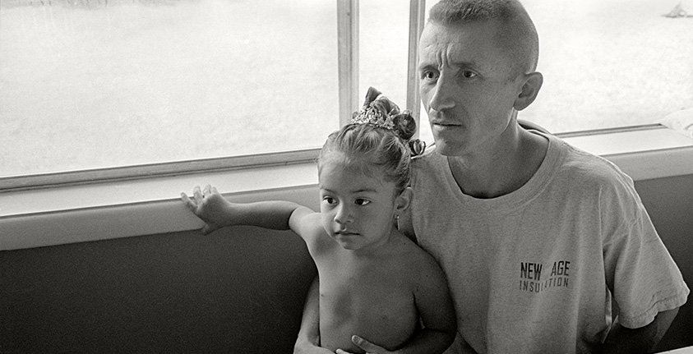
Notes:
http://kathyalanderos.com/tierranuestra/three.html
Visual Thinking Strategies
Look closely at the picture and think about the following three questions:
What is going on in this picture?
What do you see that makes you say that?
What more can you find?
Primary Source Analysis
Author: Who created the image? What do you know about the author? What is the author's point of view?
Place and time: Where and when was the image produced? How might this affect the meaning of the image?
Prior knowledge: Beyond information about the author and the context of its creation, what do you know that would help you further understand the image? For example, do you recognize any symbols and recall what they represent?
Audience: For whom was the image created and how might this affect the reliability of the image?
Reason: Why was this image produced, and how might this affect the reliability of the image?
The main idea: What is the purpose of the image? What message is it trying to convey?
Significance: Why is this important?
Sources:
https://www.daummuseum.org/learn/vts/
https://secure-media.collegeboard.org/apc/ap05_ushist_greer_2_p_50286.pdf
http://researchguides.library.vanderbilt.edu/c.php?g=68881&p=446169

Slide 11
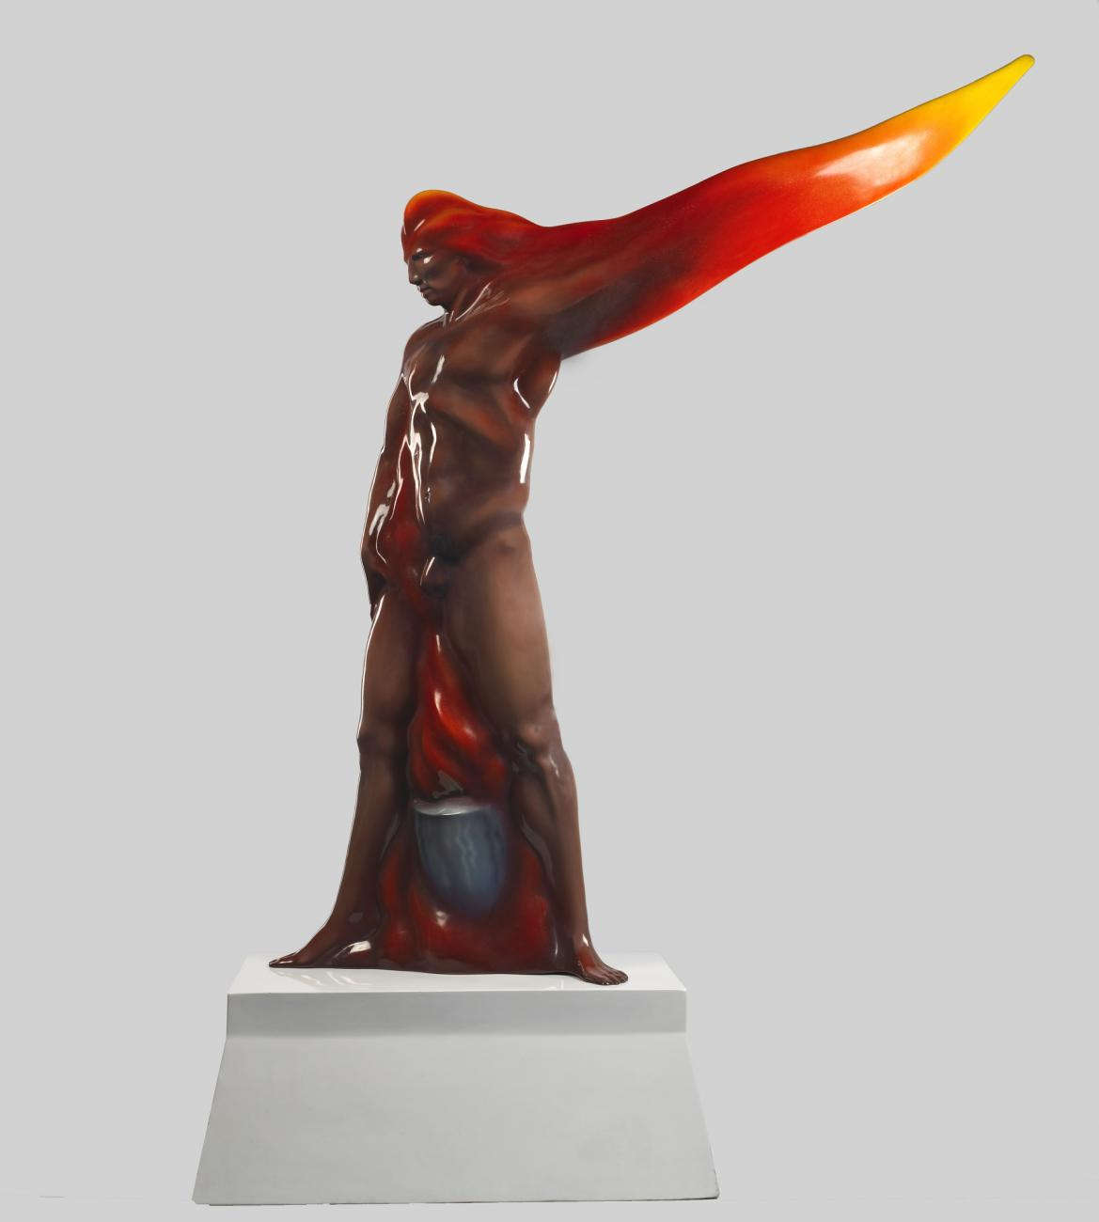
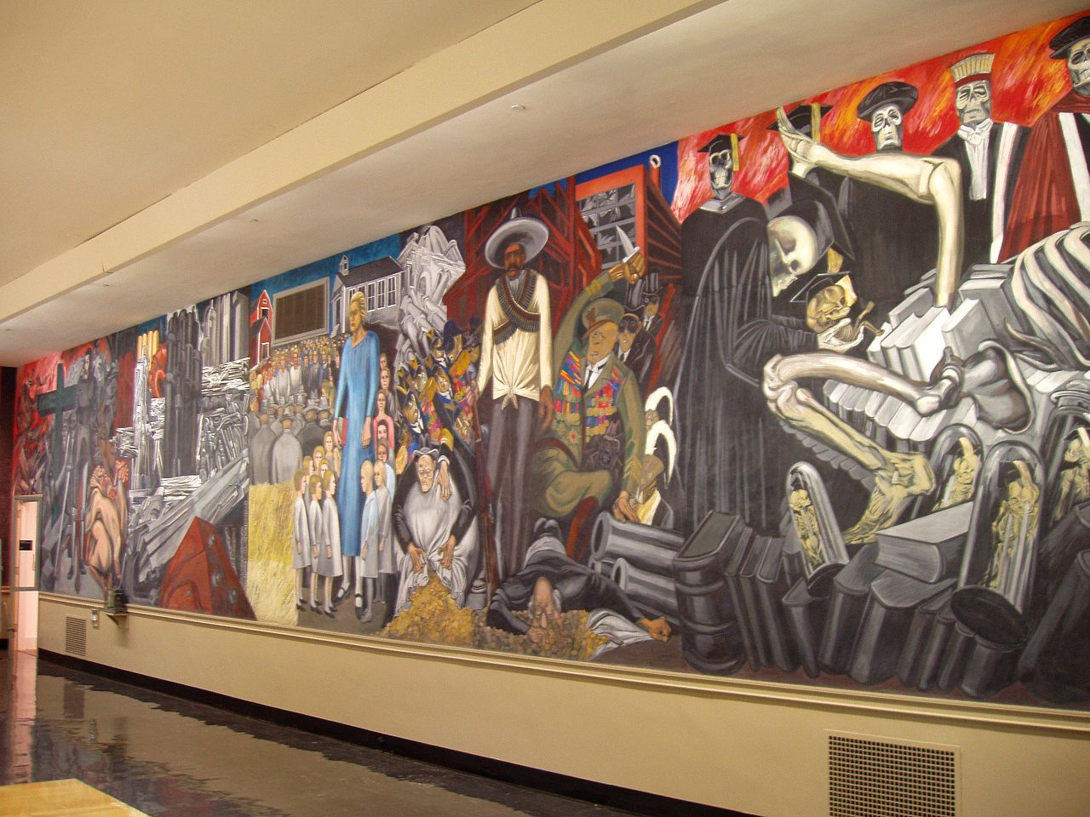
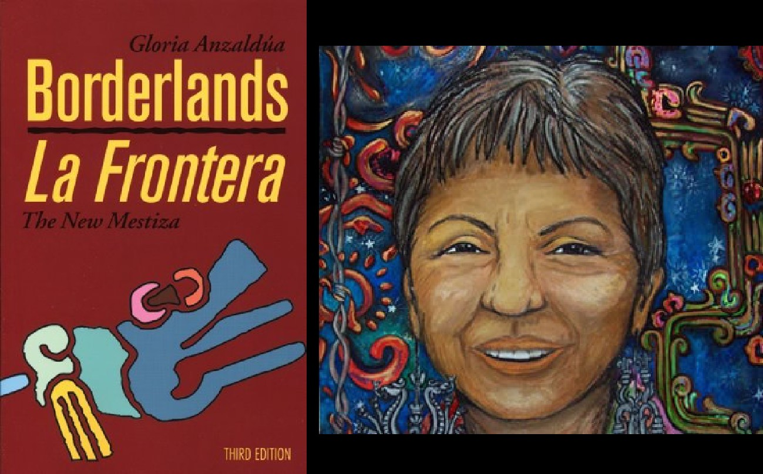
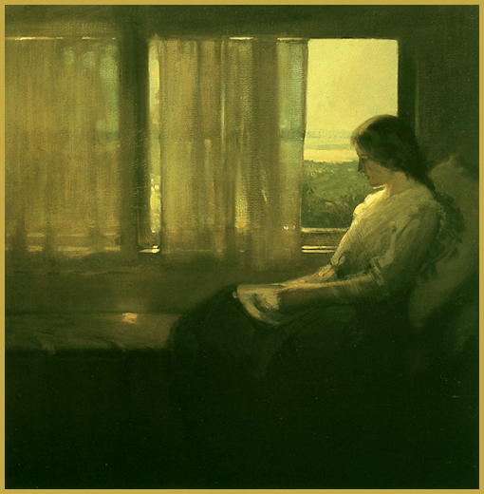
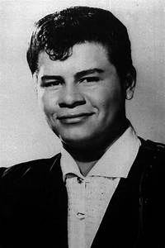
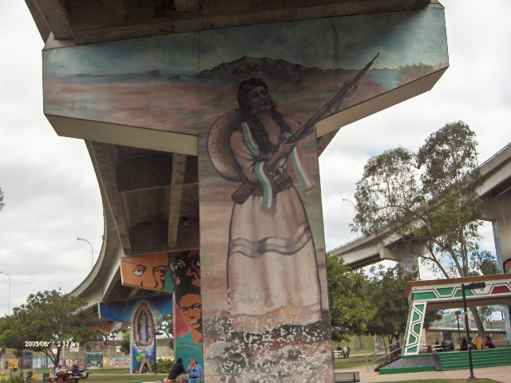
Mexican-American: Cultural Diversity in the U.S.

Slide 12
What is culture?
Culture is defined as the shared patterns of behaviors and interactions, cognitive constructs, and affective understanding that are learned through a process of socialization.
What is biculturalism?
Simultaneously maintaining one’s cultural heritage and adopting a new cultural identity.
Notes:
Sources: http://carla.umn.edu/culture/definitions.html (Note for teacher: This website has multiple definitions of culture.)
https://culcog.berkeley.edu/Publications/2009JCCP_Biculture.pdf

Slide 13
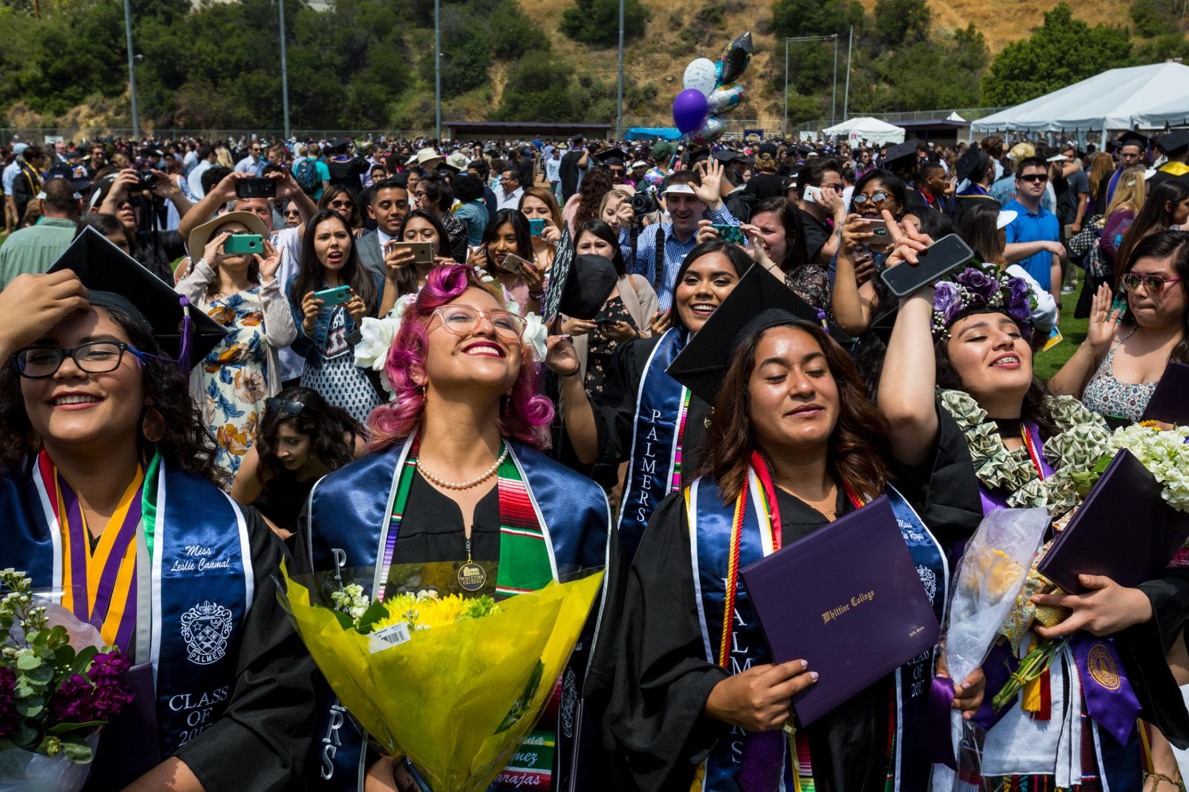
What is diversity?
“Diversity” refers to both an obvious fact of human life—namely, that there are many different kinds of people—and the idea that this diversity drives cultural, economic, and social vitality and innovation.
Notes:
Source: https://greatergood.berkeley.edu/topic/diversity/definition

Slide 14
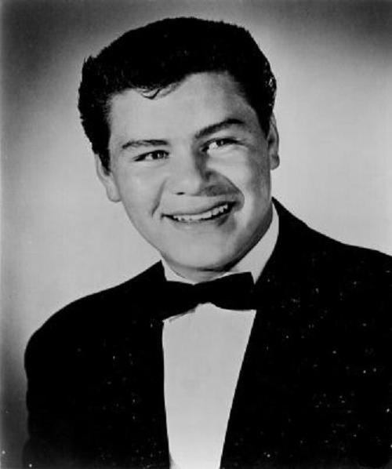
Richie Valens (Richard Stevens Valenzuela)
Born in Los Angeles, CA
Parents from Mexico
Inspired by different genres of Latinx and American music
Rock and roll and Chicano rock pioneer
Died February 3, 1959 at age 17

Slide 15
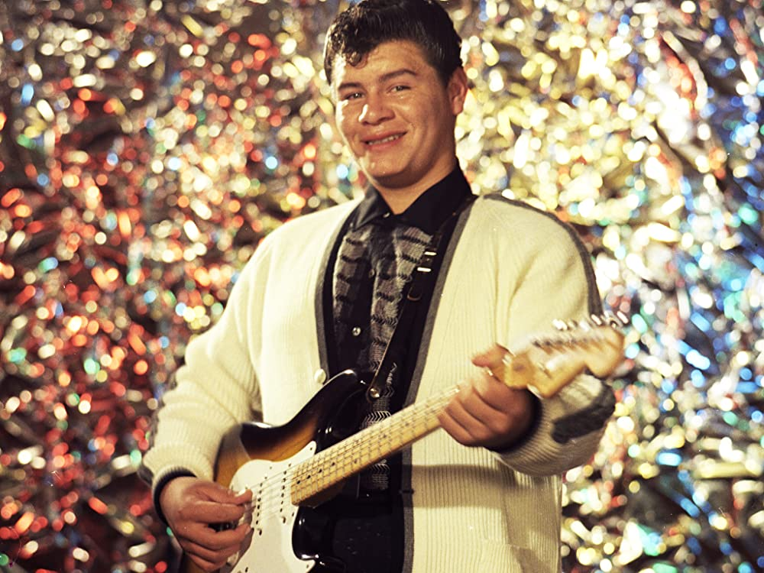
La Bamba
18th-century folk song from the Veracruz region.
Dance performed mainly at weddings
Bamba is an African name meaning `wood.’
People dancing on a wooden floor
African roots link Veracruz by way of Cuba
Possible link to the Yucatan Peninsula
Richie Valens combined Mexican folk song with American rock and roll.
Song became a national hit 1958
https://www.youtube.com/watch?v=-WoMCOtPkY8
Notes:
Source: https://www.npr.org/2000/07/15/1079558/npr-100-la-bamba

Slide 16
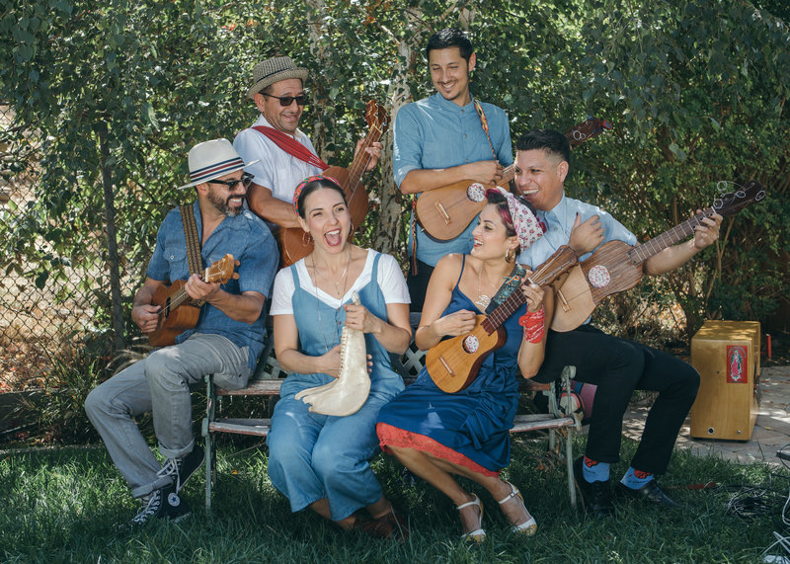
The Mexican-American tradition of La Bamba continues…
La Bamba by Los Lobos (1987)
This was the first #1 US hit with lyrics entirely in Spanish.
La Bamba Rebelde by Las Cafeteras (2012)
Includes traditional folk sounds with socio-political lyrics
https://www.youtube.com/watch?v=9xv-FjbXaqk

