Slide 1
Notes:
Slide 1: Utilizing the Visual Thinking Strategies (VTS) approach (Yenawine, 2013), allow students 1-2 minutes to view the image silently. Then prompt analysis and discussion (having students build on each other’s observations) by asking:
What’s going on in this photograph?
What do you see that makes you say that?
What more can we find?
Probe further by asking:
When do you think this photo was taken?
Where?
For what purpose?
Debrief the discussion of the image by telling students that the photo was taken by Israeli artist and photojournalist Miki Kratsman. It is part of a work titled The Bedouin Visual Archive (2015 – 2016). This particular image comes from the Bedouin village of El-Arakib in the south of Israel. Miki Kratsman lived in the Negev documenting the lives of the Bedouin and the demolitions of the villages of the Israeli government.

Slide 2
The Bedouin Visual Archive
Miki Kratsman
Notes:
Say: Through this photographic archive, Kratsman reveals the daily lives of Bedouins in the Negev desert. Today we will discuss the history of the Bedouin people in Israel and the significance of The Bedouin Visual Archive.

Slide 3
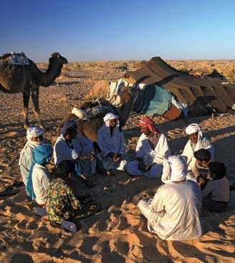
The Bedouin People
The Bedouin are a nomadic or semi-nomadic tribal people
Bedouins are animal herders including camel, goats, cattle, and sheep
Notes:
Image Credit: https://www.britannica.com/topic/Bedouin
Comprehension and Discussion Questions: What does it mean to be nomadic? What is the relationship between a nomadic lifestyle and herding animals? (i.e. Why would changing location benefit raising livestock?)

Slide 4
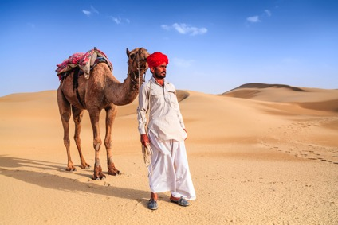
The Bedouin People
The Bedouin migrated from the Arabian peninsula in between the 14th and 18th centuries.
In the 19th and 20th centuries, the Ottoman and British empires left the Bedouin to live as they pleased in the desert.
Notes:
Image Credit: https://www.myjewishlearning.com/article/the-bedouin-in-israel/
Discussion question: Why might larger empires, such as the Ottomans and then the British, pay little attention to activities in the desert? (consider natural resources and the business of colonialism around the world)

Slide 5
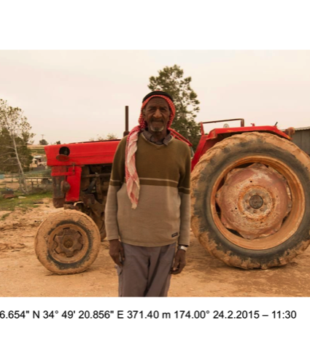
The Bedouin People
Many Bedouin have ceased nomadic practices and no longer depend on herded animals for survival.
The Bedouin maintain tribal loyalties, codes of honor, and a rural lifestyle
Notes:
Image Credit: Miki Kratsman
Discussion Question: Why might a previously nomadic tribe prefer to live in a rural, rather than urban, environment?

Slide 6
A Brief History of the Negev Bedouin
Notes:
Image Credit: Miki Kratsman
Ask:
What do you see in this photograph?
When is this photo from? How can you tell? (Note the time stamp September 26, 2017)
Given what you know about the artist, Miki Kratsman, why do you think he took this photograph? How did you come to that conclusion?
What does this photograph tell you about the Bedouin culture? What do you see that makes you say that?
To better acquaint students with the Bedouin people, they will read a brief history of the Bedouin in the Negev desert, completing a timeline charting the status of Bedouin land ownership in Israel as they read.

Slide 7
Notes:
The Bedouin Visual Archive Project is aiming to use narrative and visual literacy to raise awareness to the rights violations of the Bedouin and give voice to their silenced histories and claims on the land. The Archive is an ambitious step in the Negev Coexistence Forum (NCF) Human Rights Campaign. The archive platform will be trilingual and one of a kind in terms of its contribution to activism, research, the art world and policymaking. The aim is to produce a comprehensive and user-friendly database of photographs, maps and stories that make public a history of the region that respects the experience of its Bedouin inhabitants. The Bedouin communities living in the Negev-Naqab today have a long and complex relationship with the region. They are formally Israeli citizens and many are a part of the broader Palestinian Arab minority who stayed within Green Line Israel after the establishment of the state in 1948. It is important to note, however, that although Palestinians and Bedouins share an ancestry, not all Bedouins consider themselves Palestinians. There are roughly 240,000 Bedouins living in the Naqab-Negev region of what is today southern Israel; 60% of Naqab-Negev Bedouin live in six state-designed towns and one city, while the rest live in 11 recognized villages and 35 unrecognized villages. The communities living in the unrecognized villages are resisting this state-sponsored policy of house demolition, forced relocation and land expropriation.
The artist (Kratsman, 2018) has explained that he realized it was just a matter of time before certain places, buildings, and people will cease to exist in the Negev. So he attached geo-markers to the images to situate hem in time and space, even after they cease to exist physically.

Slide 8
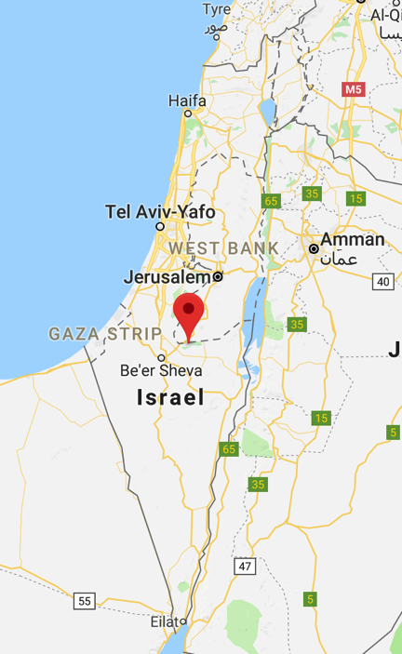

Slide 13
Reflection
The aim of The Bedouin Visual Archive is to produce a comprehensive and user-friendly database of photographs, maps and stories that make public a history of the region that respects the experience of its Bedouin inhabitants.
  What is the significance of sharing this history?
  What role should the international community have with respect to the Bedouin situation?

