Slide 1
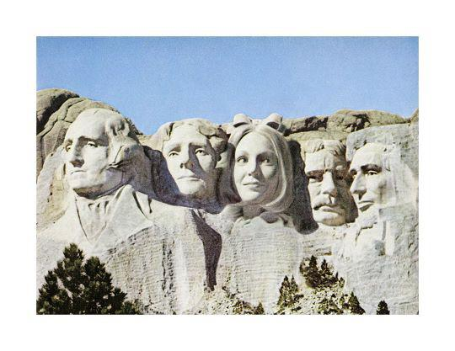
Hank Willis Thomas
The Quest for Equality:
Human Rights & Women’s Civil Rights through Art

Slide 2
Chalk Talk
In your opinion, what are ‘human rights’?
Notes:
Independently, without talking, have each student think about the question and take turns writing their response on the classroom white board (or other board). Once all responses are recorded, engage students in a discussion based on their responses.

Slide 3
Notes:
Have students watch this 9:51 minute video from “Youth for Human Rights” about Human Rights.
If the video does not open, you can retrieve it at:
https://www.youtube.com/watch?v=oh3BbLk5UIQ&list=PLCDEA2A9A2B909933
Or from the source at: https://www.youthforhumanrights.org/what-are-human-rights/

Slide 4
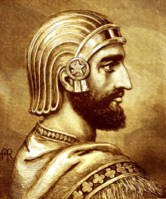
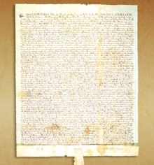
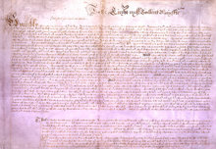
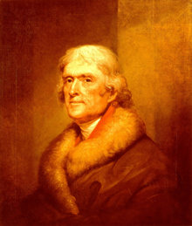
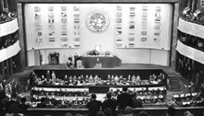
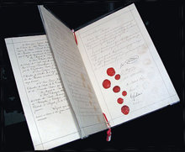
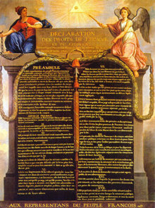
Brief history of human rights
The Cyrus Cylinder (539 B.C.)
The Spread of Human Rights
The Magna Carta (1215)
Petition of Right (1628)
US Declaration of Independence (1776)
The Constitution of the US(1787) & Bill of Rights (1791)
Declaration of the Rights of Man and of the Citizen (1789)
The First Geneva Convention (1864)
The United Nations (1945)
The Universal Declaration of Human Rights (1948)
Notes:
Images retrieved from: https://www.humanrights.com/
As the video explained, the quest for human rights has a long history. Take a few minutes to review the following key events and the role each event played in advancing human rights:
The Cyrus Cylinder (539 B.C.)
The Spread of Human Rights
The Magna Carta (1215)
Petition of Right (1628)
United States Declaration of Independence (1776)
The Constitution of the United States of America (1787) and Bill of Rights (1791)
Declaration of the Rights of Man and of the Citizen (1789)
The First Geneva Convention (1864)
The United Nations (1945)
The Universal Declaration of Human Rights (1948)
Detailed information on each of the above events can be found at: https://www.humanrights.com/what-are-human-rights/brief-history/

Slide 5
Notes:
In 1948 the United Nations adopted the Universal Declaration of human Rights. This declaration is often known as the international Magna Carta.

Slide 6
United Nations Universal declaration of human rights
We are all born free and equal | Don’t discriminate | The right to life | No slavery | No torture
You have rights no matter where you go | We’re all equal before the law | Your human rights are protected by law | No unfair detainment | The right to trial
We’re always innocent till proven guilty | The right to privacy | Freedom to move | The right to seek a safe place to live | Right to a nationality
Marriage and family | The right to own your own things | Freedom of thought | Freedom of expression | The right to public assembly
The right to democracy | Social security | Workers’ rights | The right to play | Food and shelter for all
The right to education | Copyright | A fair and free world | Responsibility | No one can take away your human right
Notes:
Pass out the Universal Declaration of Human Rights (UDHR) handout to each student. Explain that this is an abridged copy of the UDHR. The 30 universal human rights are listed on the handout and on this slide. Have students take turns reading each of the 30 rights one at a time and engage the class in a discussion on each right.

Slide 7
poll
Poor
Excellent
Notes:
Using the ppt slide image displayed on the wall/screen, have students place a sticky note on the wall/screen where they believe the US is fairing on upholding the following human rights:
Don’t Discriminate
Food and Shelter for All
Right to an Education
Student Choice (ask the class which Human Right they would like to poll)
If you are a BYOD school, consider creating a poll using polleverywhere (https://www.polleverywhere.com) in lieu of this slide.

Slide 8
Notes:
If the video does not open, you can retrieve it from: https://youtu.be/wTHyeNwo-Fo
Have students watch this 1:02 minute video on the 30th human right and ask students to share their thoughts on this right.

Slide 9
Exit slip
“Where, after all, do universal human rights begin? In small places, close to home - so close and so small that they cannot be seen on any maps of the world. Yet they are the world of the individual person; the neighborhood he lives in; the school or college he attends; the factory, farm, or office where he works. Such are the places where every man, woman, and child seeks equal justice, equal opportunity, equal dignity without discrimination. Unless these rights have meaning there, they have little meaning anywhere. Without concerted citizen action to uphold them close to home, we shall look in vain for progress in the larger world.” -Eleanor Roosevelt
Notes:
Have a volunteer read the quote aloud to the class.
Ask students the following question:
“What point is Eleanor Roosevelt trying to make?”
“What role can you play in upholding human rights?”
Have students write their responses down. Collect the responses.

Slide 10
Chalk Talk
In your opinion, do women have equal rights to that of men in the United States today?
Defend your response.
Notes:
Independently, without talking, have each student think about the question and take turns writing their response on the classroom white board (or other board). Once all responses are recorded, engage students in a discussion based on their responses.

Slide 11
DO NOW: Look closely at the picture and write down your responses to the following:
What is going on in this picture?
What do you see that makes you say that?
What more can you find?
Notes:
DO NOW: Look closely at the picture and write down your responses to the following:
What is going on in this picture?
What do you see that makes you say that?
What more can you find?

Slide 12
Notes:
This is the original image from 1945.
Ask students to independently analyze this image. Then ask a volunteer to read the caption under the image. Ask the class if the caption alters their perception of the image? If so, in what ways?

Slide 13
Hank Willis Thomas SN11548.7 – Print The Men Cheered! 1945/2015, 2015
Notes:
Explain that the advertisement was altered to reflect the present image by artist Hank Willis Thomas, a conceptual artist. Conceptual art is when the idea behind the work is often more important than the aesthetic, technical, and material concerns and/or the work itself. Point out to students the title of the picture and original date and Hank Willis Thomas’ date. Explain that this altered image of an advertisement is part of his larger exhibition titled, “Unbranded: A Century of White Women, 1915-2015.”
Information about this series by Hank Willis Thomas can be found at:
https://www.wmagazine.com/gallery/hank-willis-thomas-white-women-advertising/

Slide 14
WwIi & Women in in the workforce
While some women in the US worked outside the home prior to WWII, the war changed the type and volume of work women did.
Five million women were in the US workforce from 1940-1945, mostly in plants, factories, and office jobs.
350,000 US women served in the armed forces during the war.
Women's Armed Services Integration Act signed into law June 12, 1948 recognized women, for the first time, as full members of the armed forces.
Working women faced many issues and cultural stereotypes.
Minority women faced hardships securing jobs.
Many women were fired or laid off after WWII as men returned home and took positions and the need for war materials decreased.
By 1932, 32% of women were in the workforce.
Notes:
Provide students with a brief history of women in WWII.
Detailed information on WWII & Women in the Workforce can be found at:
https://www.nationalww2museum.org/students-teachers/student-resources/research-starters/women-wwii
https://www.khanacademy.org/humanities/us-history/rise-to-world-power/us-wwii/a/american-women-and-world-war-ii

Slide 15
Notes:
Look closely at the picture and write down your responses to the following:
What is going on in this picture?
What do you see that makes you say that?
What more can you find?

Slide 16
Notes:
This is the original image from 1973. Ask students to independently analyze this image. Then ask a volunteer to read the caption under the image.
Ask the class if the caption alters their perception of the image? If so, in what ways?

Slide 17
Hank Willis Thomas SN115a48.10 – Print Behind every great man…, 1973, 2015, 2015
Notes:
Point out to students the title of the picture and original date and Hank Willis Thomas’ date. Explain that this altered image of an advertisement is part of his larger exhibition titled, “Unbranded: A Century of White Women, 1915-2015.”
Engage students in a conversation about the history of Mount Rushmore, including the push for Susan B. Anthony, a US women’s suffrage activist, to be included on Mt. Rushmore.
Ask students the following question: what do these modified ads have in common? Based on student responses, engage students in a conversation about women’s civil rights and how artwork addresses and can be used as a medium of awareness and change.
This website provides detailed information: https://www.npca.org/articles/1755-a-woman-on-mount-rushmore

Slide 18
Suffrage
Suffrage: The right to vote in political elections
Notes:
Image retrieved from: https://www.wvxu.org/post/exhibit-examines-ohios-forgotten-role-womens-suffrage-movement#stream/0
Let the students know that for the remainder of the lesson, we will focus primarily on one of women’s civil rights—suffrage.

Slide 19
Susan B. Anthony 1820-1906
Notes:
Image Retrieved from: https://www.womenshistory.org/education-resources/biographies/susan-b-Anthony
Take a few minutes to talk with students about Susan B. Anthony.
Talking points:
Leader of the woman’s suffrage movement & abolition activist
In 1869 founded the National Woman Suffrage Association with Elizabeth Cady Stanton
In 1872 she was arrested and fined for voting
1890 merged the National Woman Suffrage Association and the American Woman Suffrage Association
Detailed information on Susan B. Anthony’s life can be found at: https://www.womenshistory.org/education-resources/biographies/susan-b-Anthony
Detailed information on the National Woman Suffrage Association: http://www.crusadeforthevote.org/nwsa-organize/
Detailed information on the National American Woman Suffrage Association: http://www.crusadeforthevote.org/nawsa-united/

Slide 20
19th amendment August 26, 1920
“The right of citizens of the United States to vote shall not be denied or abridged by the United States or by any state on account of sex. Congress shall have power to enforce this article by appropriate legislation”
Notes:
Ask for a volunteer to read the 19th amendment aloud to the class.
Engage the class in a conversation on the history of the 19th amendment.
Detailed information on the history of the 19th amendment can be found at: https://www.nps.gov/articles/2020-crash-course.htm

Slide 21
On women’s right to vote
“It was we, the people; not we, the white male citizens; nor yet we, the male citizens; but we, the whole people, who formed the Union. And we formed it, not to give the blessings of liberty, but to secure them; not to the half of ourselves and the half of our posterity, but to the whole people - women as well as men. And it is a downright mockery to talk to women of their enjoyment of the blessings of liberty while they are denied the use of the only means of securing them provided by this democratic-republican government - the ballot.”
-Susan B. Anthony
Notes:
Pass out the handout, “On Women’s Right to Vote.” Explain to students that this is a very important speech made by Susan B. Anthony after her arrest for casting an illegal vote in the presidential election of 1872. She was tried and then fined $100 but refused to pay.
Once students have all independently read the speech, ask them to reread the second paragraph.
Ask all students to think about what emotions this paragraph evokes in them. Once they have determined their emotion, ask them to stand or raise one hand. Once all students are standing or raising a hand, have a volunteer share and then sit down/lower hand. If anyone else has the same or similar response, they should also sit down/lower hand. Repeat until all are sitting/hands down. As students are sharing, you are to record their responses on the board.
Have students look over the list generated and engage in a discussion on whether or not the statement is still relevant today for women. For all people.
Speech retrieved from: http://www.historyplace.com/speeches/anthony.htm

Slide 22
19th amendment: ‘A Start, Not A Finish'
Notes:
If the video does not open, you can retrieve it from: https://www.youtube.com/watch?v=XcrGQ0npuCw
Have students watch this 6:04 minute video on the 19th amendment. Prior to starting the video, remind students that 2020 marks the 100 year of the 19th Amendment.

Slide 23
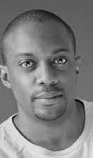
About the Artist
Notes:
Retrieved from: https://www.hankwillisthomas.com/BIO/1
Share with students that Hank Willis Thomas is a conceptual artist whose word centers on perspective, identity, commodity, media, and popular culture. His work has been shown throughout the U.S. and abroad. He earned an B.F.A. from New York University and an M.A./M.F.A. from the California College of the Arts. He was honored with honorary doctorates from the Maryland Institute of Art and the Institute for Doctoral Studies in the Visual Arts, Portland, ME in 2017.

Slide 24
Inside-outside Circles
“How do we continue to redefine and open new doors for other people to get more access to liberty and justice?”
--Hank Willis Thomas
While directly referring to the Black Lives Matter movement, in what ways may Thomas’ question pertain to human rights? To women’s rights?
Notes:
Article: https://www.theguardian.com/artanddesign/2020/jul/30/hank-willis-thomas-afro-pick-sculpture-activism
Organize students into two circles of equal numbers. Each student in the outside circle should be facing a student in the inside circle so that students are broken up into pairs (one outside circle student with one inside circle student). Explain to students that they will engage in an inside-outside circle activity. Directions include 30 seconds of silent thinking after given a quote from the artists and corresponding question followed by 30 seconds of uninterrupted sharing from the outside member of the pair, 30 seconds of uninterrupted sharing from the inside member of the pair, and one minutes of collaborative talk. Students in the outside circle will then rotation clockwise one student and repeat the process.
Round 1
In an article where Hank Willis Thomas spoke about the Black Lives Matter movement and his sculpture called, “All Power to All People” he made the following statement:
“I am looking forward to the moment where a lot of things I’m talking about are the norm. How do we continue to redefine and open new doors for other people to get more access to liberty and justice?” Discuss your thoughts on this question. While directly referring to the Black Lives Matter movement, in what ways may his question pertain to human rights? Women’s rights?

Slide 25
Inside-outside Circles
"It’s all about framing and context, that whoever’s framing gets to tell the story. The truth is a contentious space.”
--Hank Willis Thomas
Who is framing the story of human rights? Of women’s rights?
What is the message?
Notes:
Article: https://www.theartnewspaper.com/interview/hank-willis-thomas-public-art-is-propaganda-frankly
In an interview, Hank Willis Thomas states, “It’s all about framing and context, that whoever’s framing gets to tell the story. The truth is a contentious space.” Discuss your thoughts on this statement. Who is framing the story of women’s rights? Human rights? What is the message?

Slide 26
Emmeline Pankurst’s Freedom or Death (1913)
Notes:
If the video does not open, you can retrieve it from: https://www.theguardian.com/theguardian/2007/apr/27/greatspeeches
Explain that Emmeline Pankurst was part of the Woman’s Suffrage movement in England who came to the Hartford, Connecticut on November 13, 1913 to deliver a speech about the movement. This video includes parts of this famous speech titled, Freedom or Death. Have student watch the 3:55 minutes video and engage them in a conversation about equal rights, the women’s suffrage movement, and who “frames” the story of the women’s suffrage movement. Possible conversation starters include:
“How powerful is the vote?”
“Throughout history there seems to always have been a people of power and a people who are suppressed. Why do you think this is so?”
“Who frames the story of the women’s suffrage movement?”
“In what ways is Emmeline Pankurst’s speech relevant to today’s society?”

Slide 27
Women’s Civil Rights movement
What are the consequences (effect of the action) of the women’s civil rights movement?
Where is there room for opportunity and growth?
Notes:
Engage the class in a conversation on the following:
What are the consequences (effect of the action) of the women’s civil rights movement?
Where is their room for opportunity and growth?

Slide 28
Gender Equality Today
Men still outnumber women in elected and leadership positions.
In 2018, the average full-time woman worker made 82% in salary of what a full-time working man made (US Census Bureau).
United States ranks 53rd in gender equality worldwide.
Notes:
Close the lesson by talking about gender inequalities that still exist today. Detailed information can be found at: https://today.tamu.edu/2020/08/18/what-modern-social-justice-activists-can-learn-from-the-womens-suffrage-movement/
Ask students to do a quick think-write-pair-share centered on the following prompt:
Three takeaways or things you learned from this lesson
Two interesting facts you learned from this lesson.
One question you still have after engaging in this lesson.

Slide 29
The Quest for Equality: Human Rights &
Women’s Civil Rights
Critically analyze the present state of human rights and/or women’s civil rights in the U.S. Creatively express your analysis using any medium you wish.
Notes:
Have students critically analyze the present state of human rights and/or women’s civil rights in the US. Have students creatively express their analysis using a desired medium (speech, song, dance, poetry, sculpture, drawing, cartoon, video, photograph).

