Slide 1
The Commonwealth of Puerto Rico
Karlo Andrei Ibarra,
Puerto Rican artist
Notes:
Click to advance to the next slide.

Slide 2
Stand & Share
What do you know about Puerto Rico?
List all that comes to mind.
Notes:
Image retrieved from: https://en.wikipedia.org/wiki/Flag_of_Puerto_Rico
Ask students to engage in a stand and share activity based on the following question:
What do you know about Puerto Rico?
Process for Stand and Share: Based on the question, each student is to write down all that comes to mind. Once done, students are to stand, if able, or raise a hand to signify they are done. One at a time (volunteers) students are to share one thing on their list that addresses the question and then sit down/lower hand. If a student has the same response as the one shared and does not have anything else on the list or all responses are shared, that student can sit or lower hand once the response is shared. This continues until all responses from all students are shared aloud. The teacher (or a peer) writes down all responses on the board so all can see the complete list of responses. Once done, have a student read the list aloud to the class.
Please Note: there may be some fallacies on the list. Depending on the nature of the fallacy, the teacher can address the fallacy now or wait and circle back to it, when appropriate.
Click to advance to the next slide.

Slide 3
Puerto Rico
Locate Puerto Rico (click here for Google Earth)
Zoom in on Puerto Rico (click here to zoom in)
Read About Puerto Rico (click here for the article)
Notes:
Image Retrieved from: http://blogs.bu.edu/guidedhistory/historians-craft/puerto-rico-a-study-of-the-worlds-largest-stateless-nation/
Image Retrieved from: https://commons.wikimedia.org/wiki/File:Magnifying_glass_icon_mgx2.svg
Image Retrieved from: https://upload.wikimedia.org/wikipedia/commons/7/71/Earth_icon_2.png
Image Retrieved from: https://icon-library.com/icon/freedom-of-speech-icon-5.html
Where is Puerto Rico Located?: Ask for a volunteer to locate Puerto Rico using Google Earth. Have the student click on the Google Earth link (first link on the slide or the link here: https://earth.google.com/web/@54.09805983,10.44935383,-87508.58735471a,40433632.68223286d,35y,0h,0t,0r) to attempt to locate Puerto Rico.
Let’s Zoom in on Puerto Rico: Then tell students that we will use Google Earth to learn more about Puerto Rico (click on the second link on the slide or the link here: https://earth.google.com/web/@18.3407753,-66.63206115,343.25303825a,901343.81046608d,35y,0h,0t,0r/data=CmQaYhJcCiUweDhjMDI5NjI2MWI5MmE3Zjk6MHhmMzM2ZWMyODE4MDQ5YjFhGajg8IKIODJAIRixTwDFpVDAKiHguYDguJvguK3guKPguYzguYLguJXguKPguLTguYLguIEYASAB).
Click the (-) button in the bottom right corner to zoom out to show Puerto Rico in relation to the surrounding countries etc. Click on the box labeled “Puerto Rico” and advance through the images of Puerto Rico to help prime students on Puerto Rico’s physical and cultural geography.
Engage students in a discussion on Puerto Rico’s geography and history. Websites to aid the discussion of Puerto Rico’s geography are included in the notes section of the PowerPoint presentation and below:
https://www.livescience.com/60792-puerto-rico-facts.html https://kids.nationalgeographic.com/geography/states/article/puerto-rico
Have students organize into groups of 4. Pass out a copy of the scholastic article titled, “All About Puerto Rico” (Link to article is on the slide or here: https://www.scholastic.com/teachers/articles/teaching-content/all-about-puerto-rico/). In small groups, have student volunteers take turns reading the article aloud to their group.
Click to advance to the next slide.

Slide 4
Puerto Rico
“It may be considered a non-place—a political experiment, a failed national project, living uncertainty in the imaginary of its inhabitants.” --Karlo Andrei Ibarra
What do you think Ibarra is referring to?
What would lead him to say this?
Notes:
Image retrieved from: https://scalar.usc.edu/works/latino-metropolis-a-brief-urban-cultural-history-of-us-latinos---1/puerto-rico-cuba-florida-map
Quote retrieved from: http://lionelcruet.com/doc/natalia_viera_isla_imaginaria_2018.pdf
Ask a volunteer to read the quote from Ibarra aloud: “It may be considered a non-place—a political experiment, a failed national project, living uncertainty in the imaginary of its inhabitants.”
In their groups of four, have students discuss their responses to the following questions:
What do you think Ibarra is referring to?
What would lead him to say this?
Click to advance to the next slide.

Slide 5
Commonwealth of Puerto Rico
Why isn’t Puerto Rico a state? (Click here for article and video)
Notes:
Website and video retrieved from: https://www.history.com/news/puerto-rico-statehood
Pull up the History article, “Why Isn’t Puerto Rico a State” and have students take turns reading the article aloud. Use the embedded links to explore key aspects of Puerto Rico’s history and relationship to the United States (e.g., Spanish-American War, Foraker Act, Jones-Shafroth Act). Have the class watch the embedded video, “Commonwealth vs. Free Associated State.” End class talking about the complexities surrounding statehood for Puerto Rico and the recent vote for statehood.
End of Day 1.

Slide 6
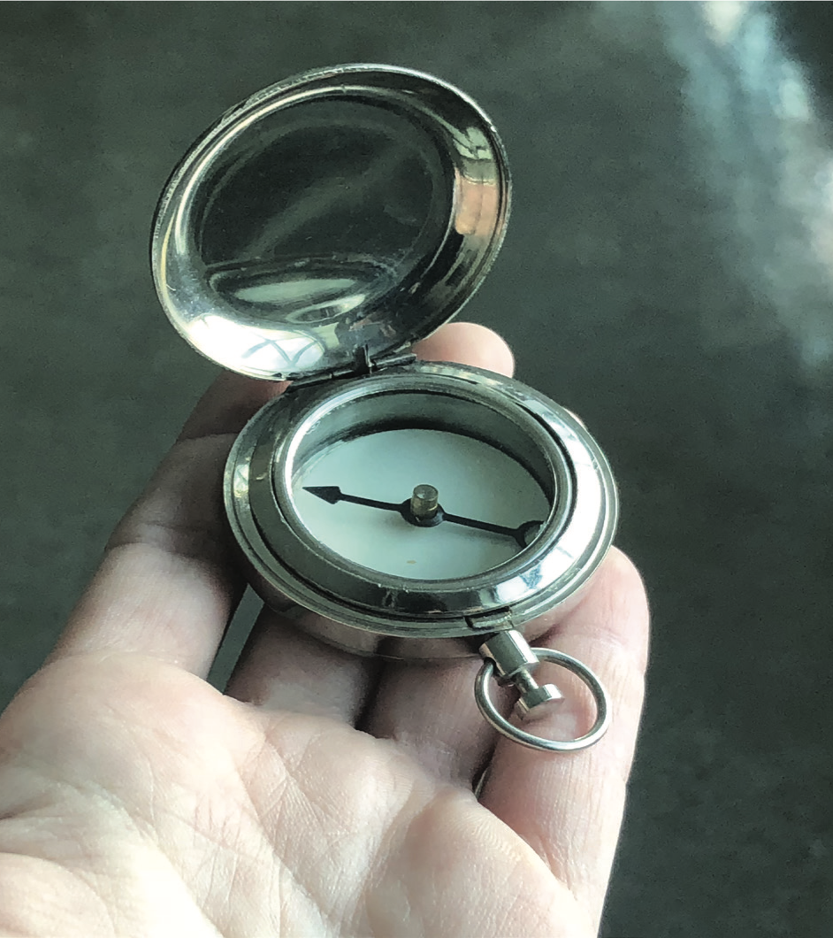
Brújula Ciega (2012-2018)
What's going on in this picture?
What do you see that makes you say that?
What more can we find?
Karlo Andrei Ibarra, Brújula Ciega/ Blind Compass, 2012-2018
Notes:
Activate PPT before class and display slide 6.
Using a combined Visual Thinking Strategies (Yenawine, 2013) approach. Ask the following questions, probing and prompting as required:
What’s going on in this picture?
What do you see that makes you say that?
What more can we find?
Explain to students that “Brújula Ciega” (which translates to Blind Compass) is a sculptural that shows a compass that is blank and has no surrounding information at all.

Slide 7
About the Artist
“I employ a wide variety of media that refer to conceptual art and mass media while addressing issues of social, political, cultural and geographic boundaries. My practice relies on social and political cognitions gathered from personal investigations, which draw correlations between individual and national identities and make larger observations respective to a global community.”
–Karlo Andrei Ibarra
Notes:
Quote and information below retrieved from: http://www.rofaprojects.com/karlo-andrei-Ibarra
Introduce the artist, Karlo Andrei Ibarra
Karlo Andrei Ibarra is a Puerto Rican-based contemporary artist who holds a Baccalaureate in Visual Arts with concentration in Painting from the School of Visual Arts and Design of Puerto Rico. Currently, he works as an artist and cultural manager. He is also cofounder of the contemporary art space in Santurce, Puerto Rico, called Km 0.2. His proposal addresses directly to Puerto Rico’s subordinate position as an unincorporated territory of the United States, and aesthetically examines the implications of this association.
Ask for a volunteer to read the following quote by the artist aloud:
I employ a wide variety of media that refer to conceptual art and mass media while addressing issues of social, political, cultural and geographic boundaries. My practice relies on social and political cognitions gathered from personal investigations, which draw correlations between individual and national identities and make larger observations respective to a global community.”
Engage the class in a conversation about ways art can serve to address issues of social, political, cultural, and geographic importance.
Pass out the handout, “Karlo Andrei Ibarra Brújula Ciega Blind Compass, 2012-2018” (directly taken from: http://lionelcruet.com/doc/natalia_viera_isla_imaginaria_2018.pdf). Have student volunteers take turns reading the handout aloud to the class.
Image source: https://despacio.cr/en/art/karlo-andrei-Ibarra
Click to advance to the next slide.

Slide 8
“Thematically, [with these pieces] I try to examine the current situation of Puerto Rico, which, after the hurricane, and before also, has remained like a totally failed project and a country somewhat adrift.” -- Karlo Andrei Ibarra
Mano Brújula
(2012-2018)
Notes:
Image and quote retrieved from: https://repeatingislands.com/2018/10/14/karlo-andrei-ibarras-cumulative-failures/
Have a student volunteer read the quote on the slide aloud, “Thematically, [with these pieces] I try to examine the current situation of Puerto Rico, which, after the hurricane, and before also, has remained like a totally failed project and a country somewhat adrift.”
Explain to students the image on the screen is titled “Mano Brújula” [translation is Compass Hand] which also addresses the social limbo of Puerto Rico.
Explain to the students that the quote by Ibarra elaborates about these pieces in relation to Puerto Rico’s current situation as a commonwealth of the United States.
Ask students, “Why may Ibarra view Puerto Rico as a “failed project” and a “country somewhat adrift?”
Click to advance to the next slide.

Slide 9
Individual & National Identity
“I employ a wide variety of media that refer to conceptual art and mass media while addressing issues of social, political, cultural and geographic boundaries. My practice relies on social and political cognitions gathered from personal investigations, which draw correlations between individual and national identities and make larger observations respective to a global community.”
–Karlo Andrei Ibarra
Notes:
Quote retrieved from: http://www.rofaprojects.com/karlo-andrei-Ibarra
Image retrieved from: https://society6.com/product/half-puerto-rican-american-flag_print
Ask students what the artist may mean by “…draw[ing] correlations between individual and national identities and make larger observations respective to a global community.”
Engage students in a discussion on:
What can make up one’s individual identity and what can make up a national identity.
Rican’s individual vs. national identity and how being a commonwealth of the United States may support/contradict these identities.

Slide 10
Taking a Stance on Puerto Rico
Take stance on Puerto Rico Statehood! Reflect your informed opinion using an artistic medium of your choice such as:
Creating a poem
Composing a song or piece of music
Drawing
Photography
Recording a video
Creating a 3-D representation
Notes:
Image retrieved from: https://en.wikipedia.org/wiki/Flag_of_Puerto_Rico
Ask students to take stance on Puerto Rico Statehood. Reflect your informed opinion using an artistic medium of your choice. Options include, but are not limited to:
Creating a poem
Composing a song or piece of music
Drawing a picture
Photography
Recording a video
Creating a 3-D representation

