Slide 1
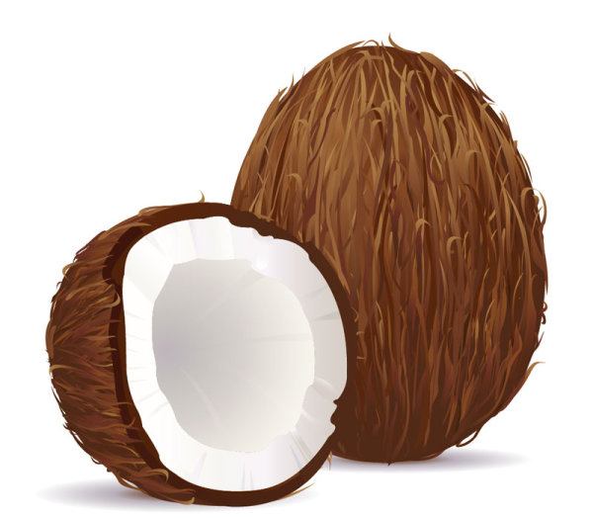
Cocos: Cultural Traditions
Think-Write-Pair-Share:
Describe one tradition (rite/custom/practice/act) you practice.
Notes:
Ask students to engage in a Think-Write-Pair-Share based on the following prompt, “Describe one tradition (rite/custom/practice/act) you practice.” After students’ share their responses, advance to slide 2.

Slide 2
Cocos: Cultural Traditions
Today’s lesson will focus on cultural traditions
Notes:
State that today’s lesson focuses on cultural traditions. Advance to slide 3.

Slide 3
Afro-Cuban
What do you think ‘Afro-Cuban’ means?
Notes:
Whole Class Conversation: Advance to slide 3. Ask students, “What do you think ‘Afro-Cuban’ means?” If unsure, point out the red circles on the map. Ask them what they think Cuba has in common with Africa. The following links can be used to aid this conversation:
https://en.wikipedia.org/wiki/Afro-Cuban
https://www.essence.com/2016/08/02/discovering-afro-cuban-culture
Advance to slide 4.
Image retrieved from: geology.com

Slide 4
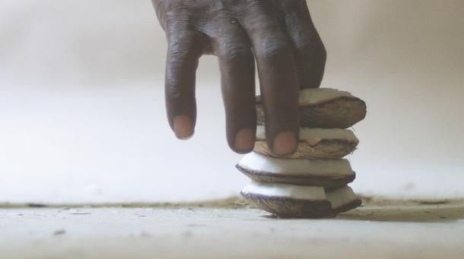
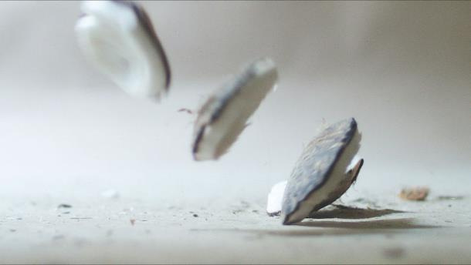
Website
Notes:
Advance to slide 4. Ask students to examine the two photographs on the screen. Using the VTS approach, ask:
What’s going on in these pictures?
What do you see that makes you say that?
What more can we find?
Tell students that the images are part of a video by artist Javier Castro that is highlighted in a four-part video series called Cuatro Cosas Básicas/Four Basic Things commissioned by USF’s Contemporary Art Museum. Pull up and display the following website that provides students with information about the artist (also hyperlinked to slide):
http://www.artcentersf.org/javier-castro/. Have a volunteer read aloud the information displayed on the website. Another great resource to share with students is Smith’s (2017) Interview with artist Javier Castro. Explain that Casro’s video series, Cuatro Cosas Básicas/Four Basic Things, is displayed in such a way that the viewer can experience all four videos running simultaneously and that these two images are from the second work in the series, Cocos.
Advance to slide 5

Slide 5
Javier Castro
“The second work speaks about uncertainty and the anxiety of seeing the future. A man repeatedly throws four pieces of coconut shells on the floor [as a divination ritual], reads the position they fall in and gives an answer—this is what normally happens. In the video, the viewer cannot get an answer because there are always pieces that fall outside of the frame. So that the reading is continually open and unresolved.”
Retrieved from: http://www.cubanartnews.org/news/5-artists-1-curator-on-climate-change-cuba-usa/6623
Notes:
Have a volunteer read the following aloud:
“The second work speaks about uncertainty and the anxiety of seeing the future. A man repeatedly throws four pieces of coconut shells on the floor [as a divination ritual], reads the position they fall in and gives an answer—this is what normally happens. In the video, the viewer cannot get an answer because there are always pieces that fall outside of the frame. So that the reading is continually open and unresolved.”
Retrieved from: http://www.cubanartnews.org/news/5-artists-1-curator-on-climate-change-cuba-usa/6623
To extend on the still images previously presented and students’ response to the images along with the author’s explanation above, share that the video from which these still images are from is of an Afro Cuban man engaging in “tirando los cocos,” throwing down shards of a coconut shell in an Afro Cuban Santeria rite to ask and obtain answers from the orishas, or spirit deities. How the pieces land provide insight to the question asked (often a yes or no question). Allow time for students to discuss their understanding of this cultural tradition. The following links can be used to aid this conversation:
http://www.religioustolerance.org/santeri3.htm
http://www.aboutsanteria.com/what-is-santeria.html
Advance to slide 6.

Slide 6
Cultural Traditions Gallery Walk
Task: Come up with the following to be displayed via a cultural traditions gallery walk:
A visual that represents your cultural tradition (rite/custom/practice/act)
A detailed label of your visual that describes (1) the image and how it is represents your tradition and (2) the significance of your tradition to you.
Notes:
Ask students to reflect back on their own cultural traditions (rite/custom/practice/act) they practice. Ask students to assume they found themselves living in another place and possibly at another time where no one knew of their cultural tradition. Charge them with describing/explaining their cultural tradition to these people who were not familiar with such a practice.
Ask students to come up with the following to be displayed via a gallery walk:
A visual that represents their cultural tradition (rite/custom/practice/act)
A detailed label of their visual that describes (1) the image and how it is represents their tradition and (2) the significance of their tradition to them.
Provide the resources necessary for students to complete this task (e.g., computer, internet access, printer, magazines, 5” x 8” index card). Devote the remainder of the period to completing this task.
Encourage students to consider the various forms of visuals (e.g., photographs, graphics, video, paintings, personal objects, sculptures). Allow time for students to select their visual and create their label using the index card provided. The label will be displayed next to the visual during the gallery walk.

Slide 7
Cultural Traditions Gallery Walk
Notes:
Divide the class into two groups. Group one will display their visual and label first. All members of group one will stand next to their visual and label ready to talk with their classmates who are walking about the room examining the products and asking questions about their work. After a set period of time the groups will switch.
Advance to slide 8.

Slide 8
Stand and Share
What did you learn as a result of engaging in the cultural traditions gallery walk?”
Notes:
Ask, “What did you learn as a result of engaging in the cultural traditions gallery walk?”
Close by reminding students that our cultural traditions are part of who we are; that culture is alive and changing constantly; and that it is via experience, observation, and reflection that we better understand and identify with our culture and the similarities and differences between cultural groups.

